Slide 1
SDL Training
Guide for SQE to review and validate completeness of SDL Supplemental Form

Slide 2
Reference Documents:
Appx QX, rev. 10
PI-002 (pgs. 5 & 6)
SQM User Guide (pg.24)

Slide 3
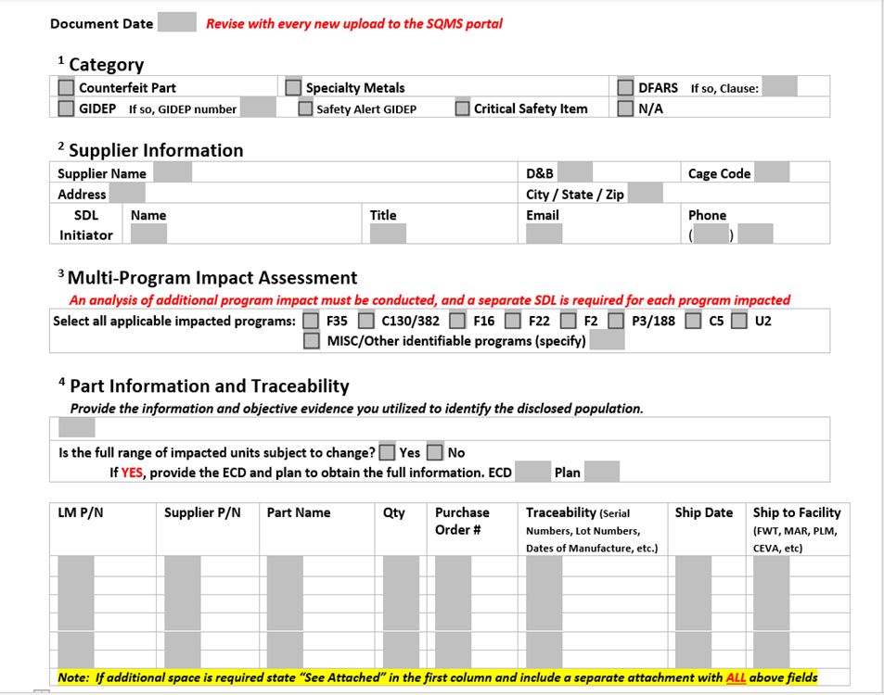
Section 1 – Category:
Verify supplier has checked the correct Category or N/A
Section 2 – Supplier Information:
Verify suppliers' information is same as in the LM Purchase Order
Section 3 – Multi Program Impact:
Ensure that an SDL is entered into SQMS for each program impacted
Section 4 – Part Information and Traceability:
Ensure that criteria used to determine the bounding is provided
If the disclosed population is provided via attachment, ensure all requested fields are included.
Confirm the total quantity of for all P/Ns is equal to the amount entered in the SQMS entry form.

Slide 4
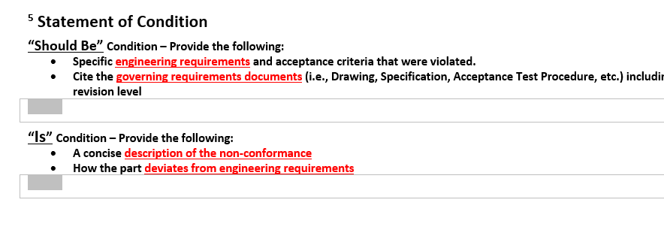
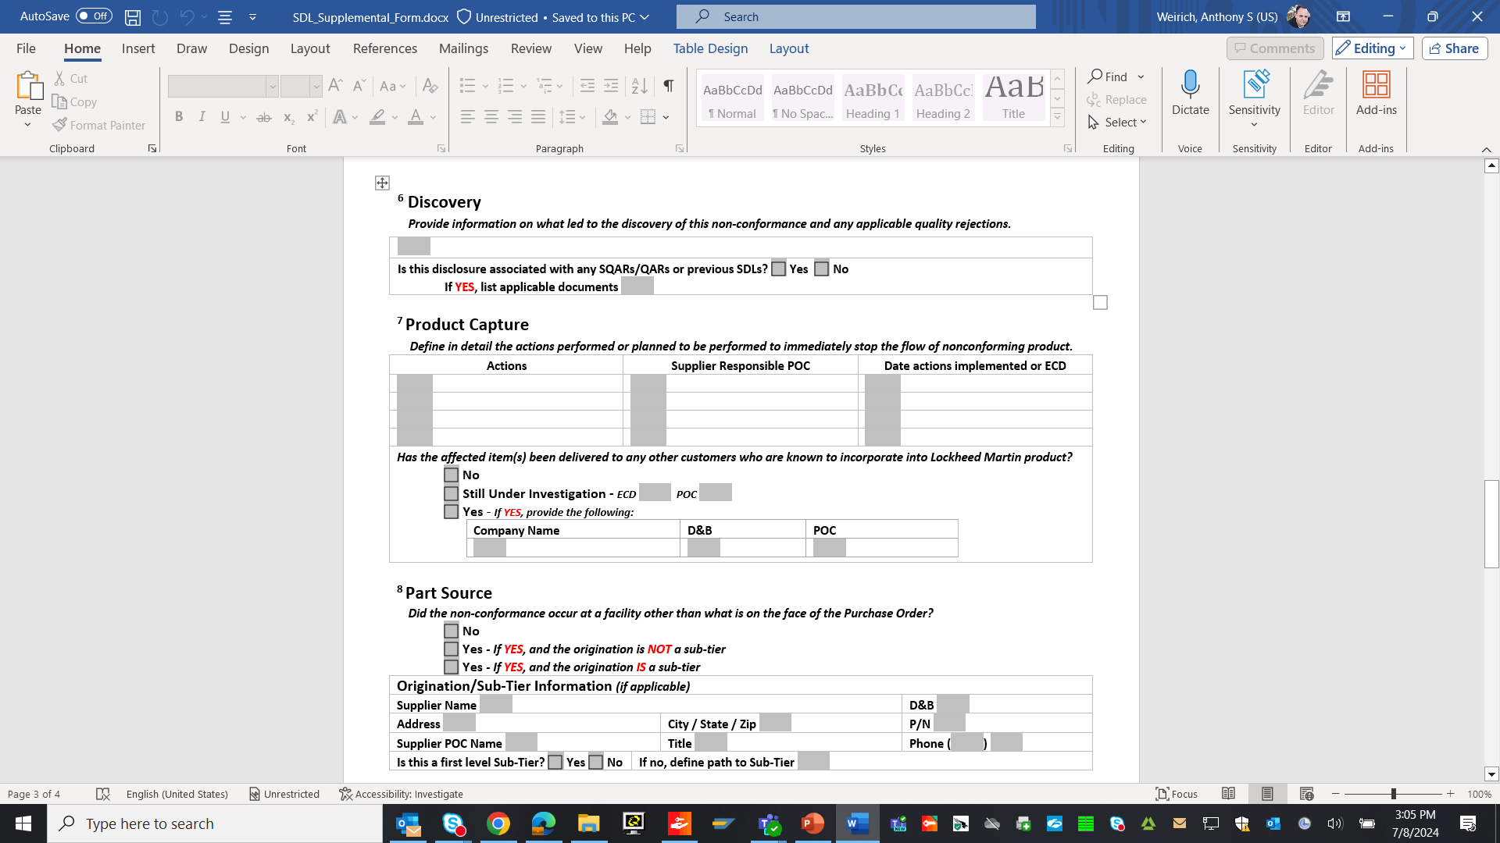
Section 5 – Statement of Condition:
"Should be" condition - Ensure that the relevant document numbers are provided. (i.e., Drawing page # and zone location are helpful should a MS request be needed for containment)
"Is" condition - Ensure that how the part deviates or potentially deviates from engineering requirements is clearly stated. Ensure that actual measurement values are included when possible. This helps LM gauge the degree of failure.
Section 6 – Discovery:
If the supplier has selected "Yes," ensure that the applicable documents are listed.
Section 7 – Product Capture:
Ensure that the supplier has answered whether product has been delivered to any other customers with the potential to affect LM. If yes, then the supplier needs to also notify that customer and list that action in this section.

Slide 5
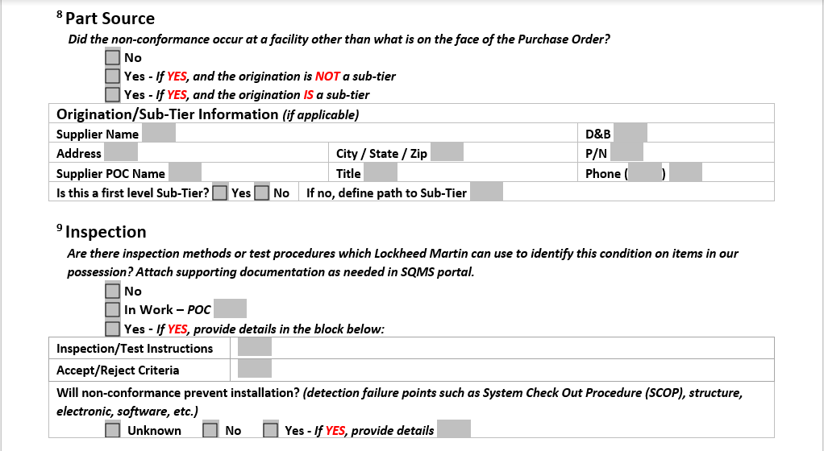
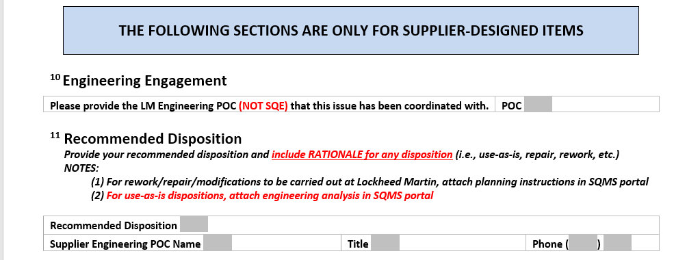
Section 8 – Part Source:
If the non-conformance occurred at a facility other than what is on the Purchase Order, verify the sub-tiers information is filled out, including POC.
Section 9 – Inspection:
List if there are any Inspection Methods or Test Procedures which LM can use to identify this condition on items in our possession.
For supplier designed items:
Section 10 – Engineering Engagement:
Ensure that an LM Engineering POC is provided (not an SQE or SQM Integrator).
Section 11 – Recommended Disposition: Ensure that the supplier's engineering analysis is attached in the SQMS portal.

