Slide 1
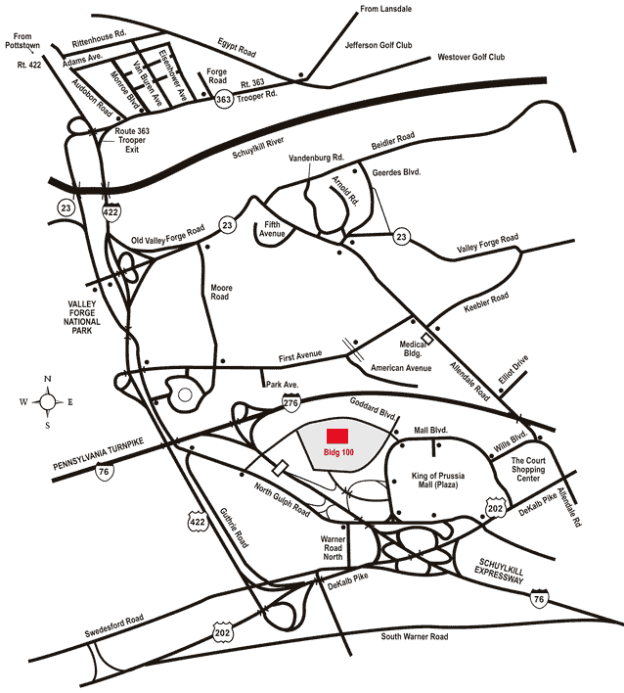
Lockheed Martin – Building 100
230 Mall Blvd, King of Prussia, PA 19406
Google Maps Link

Slide 2
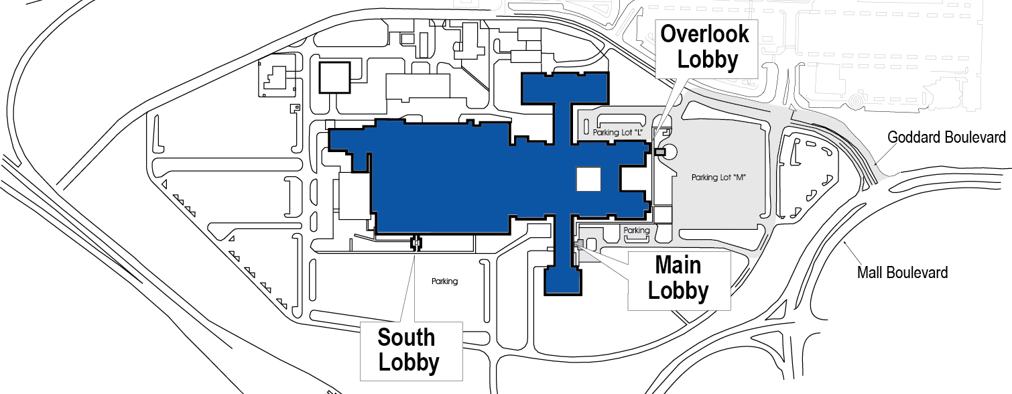
Lockheed Martin – Building 100
230 Mall Blvd, King of Prussia, PA 19406
Talent Acquisition Center
Goddard Boulevard
Bus Parking
North Gulf Road
Student Participants and Coaches
From Mall Blvd: Turn onto Goddard Blvd. Go past the light at Conrad Dr. and make the first left into the Lockheed Martin Building 100 lot.
From North Gulf Road: Turn onto Goddard Blvd. Make the fifth right into the Lockheed Martin Building 100 lot. (third right is gated)
Cars: Park in Lot “M” or Lot “L” and proceed to the Talent Acquisition Center entrance.
Buses: may drop off, or park and wait. Bus drivers must remain with their vehicle at all times while on site. Buses park in back of Lot “M”

