Slide 1
Lockheed Martin Visitor Information

Slide 2
Arriving at Lockheed Martin
Main Gate
Have government issued photo ID (driver’s license, passport, etc.) ready for inspection by security officers
The security officers will instruct you where to park and where to enter the building
Restricted Items
Cameras
Cell phones
Recording devices
Digital watches that can connect to the internet
E-readers

Slide 3
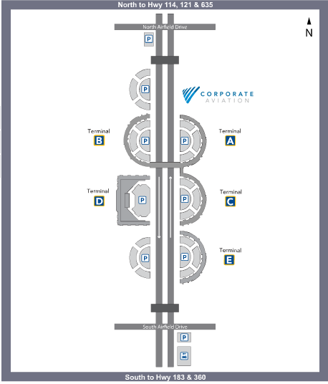
Airline Flight Information
American Airlines www.aa.com DFW: (817) 267-2222 Toll Free: 1 (800) 223-5436
Delta Airlines www.delta.com DFW: (817) 630-3200 Toll Free: 1 (800) 221-1212
United Airlines www.united.com Toll Free: 1 (800) 241-6522
DFW Airport

Slide 4
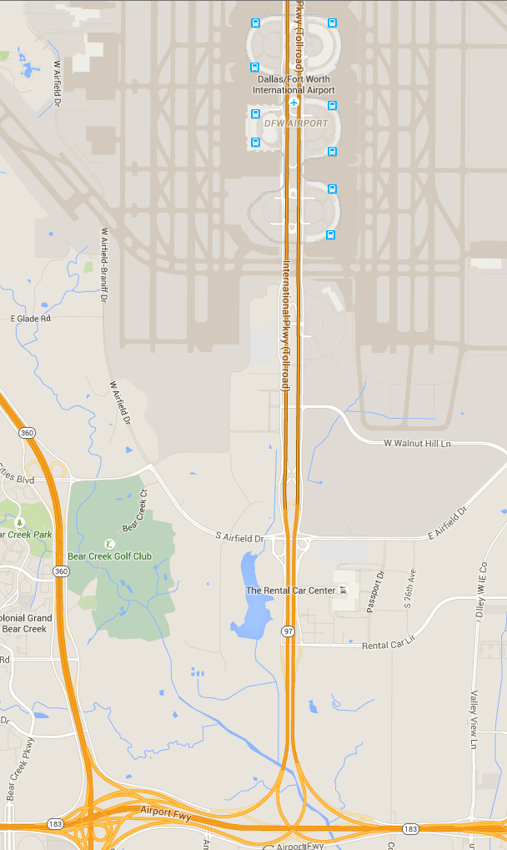
Avis Car Rental – D/FW Airport

Slide 5
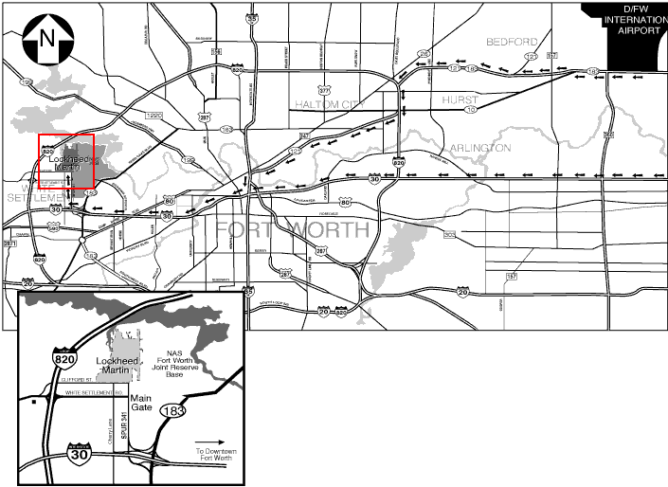
Map to Lockheed Martin from D/FW Airport
Directions from D/FW Airport to Lockheed Martin:
I-30 W, Exit 7B (Spur 341/Lockheed Boulevard) to Main Gate
I-820 W, Exit 5A (Clifford Street) to Lockheed Boulevard
Visitor parking available through Main Gate to Gate F

Slide 6
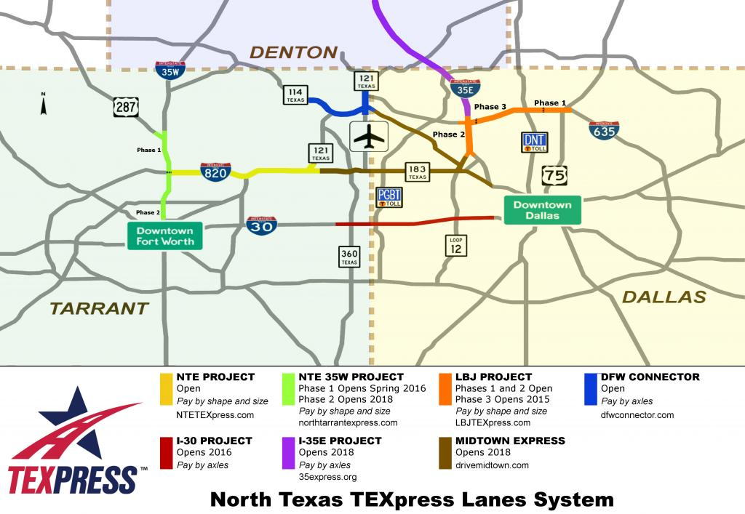
Map from D/FW to Lockheed Martin NTE TEXPRESS (Toll Road)

Slide 7
Visitor Parking
Cherry Lane
Clifford St.
BUILDING 200
LOBBY
Lockheed
Martin Blvd.
VISITOR PARKING

Slide 8

Local Hotels
Ashton Hotel 610 Main Street (817) 332-0100 www.theashtonhotel.com
Best Western Fort Worth Inn & Suites 201 West Loop 820 (817) 246-8777 www.bestwestern.com
Candlewood Suites 402 N. Jim Wright Freeway (817) 246-6800 www.candlewoodsuitesfortworth.com
Comfort Inn & Suites FW West 7801 Scott Street (817) 246-2402 www.marriott.com
Courtyard by Marriott Downtown/Blackstone 601 Main Street (817) 885-8700 www.marriott.com
Courtyard by Marriot University 3150 Riverfront Drive (817) 335-1300 www.marriott.com
Courtyard by Marriott West/Lands End 6530 West Freeway (817) 737-6923 www.marriott.com
Fairfield Inn & Suites by Marriott 1505 South University (817) 335-2000 www.marriott.com
Fairfield Inn & Suites by Marriott 1010 Houston St (817) 529-9200 www.marriott.com
Hampton Inn & Suites 2700 Green Oaks Road (817) 732-8585 www.hamptoninn.com
Hilton Fort Worth 815 Main Street (817) 870-2100 www.hilton.com
Holiday Inn Express 2730 South Cherry Lane (817) 560-4200 www.holidayinn.com
Quality Inn & Suites 2700 South Cherry Lane (817) 560-4180 www.qualityinn.com
Renaissance Worthington Hotel 200 Main Street (817) 870-1000 www.marriott.com
Residence Inn by Marriott 1701 South University (817) 870-1011 www.marriott.com
Sheraton Fort Worth 1701 Commerce (817) 335-7000 www.sheraton.com
Stockyards Hotel 109 East Exchange Avenue (817) 625-6427 www.stockyardshotel.com
Residence Inn by Marriott 2500 Museum Way (817) 885-8250 www.marriott.com

Slide 9
Local Restaurants
Barbecue
Italian
Asian
Railhead Smokehouse 2900 Montgomery Street (817) 738-9808
Angelo’s Barbecue 2533 White Settlement Road (817) 332-0357
Woody Creek Bar-B-Q
6986 Green Oaks Rd. (817) 737-2008
Soda Springs Barbecue 8620 Clifford Street (817) 246-4494
Mancuso Italian
9500 White Settlement Road
(817) 246-7041
Joe’s Pasta/Pizza
9501 Clifford Street
(817) 367-7744
The Olive Garden
925 Alta Mere Drive
(817) 732-0618
Japanese Palace 8445 Camp Bowie West Blvd (817) 244-0144
Szechuan Chinese
5712 Locke Ave (817) 738-7300
Fast Food
McDonald’s
9559 Clifford Street
(817) 246-5880
Sonic Drive In
9560 Clifford St.
(817) 246-0922
Wendy’s
1751 South Cherry Lane
(817) 367-0029
Subway
1606 South Cherry Lane (817) 367-3736
Taco Bueno
9523 White Settlement Rd.
(817) 246-3926
Mexican
Continental
Blue Mesa Grill www.bluemesagrill.com
612 Carroll Street
(817) 332-6372
Don Pablos
7050 Ridgmar Meadow
(817) 731-0497
Uncle Julio’s
5301 Camp Bowie Blvd
(817) 377-2777
Joe T Garcia’s
2201 North Commerce
(817) 626-4356
Fred’s Texas Café
www.fredstexascafe.com 915 Currie St Fort Worth, TX 76107 (817) 332-0083
Rodeo Goat
2836 Bledsoe St. (817) 877-4628
Chili’s 300 Clifford St. (817) 246-3850

Slide 10
Medical Facilities
Hospitals
Pharmacies
Baylor All Saints Medical Center Fort Worth 1400 Eighth Avenue (817) 926-2544
Baylor All Saints Medical Center at Cityview 7100 Oakmont Boulevard (817) 346-5700
Cook Children’s Medical Center 801 7th Avenue (817) 885-4000
Harris Methodist Fort Worth Hospital 1301 Pennsylvania Avenue (817) 878-5500
Harris Methodist Southwest Hospital 6100 Harris Parkway (817) 346-5000
Huguley Memorial Medical Center 11801 South Freeway (817) 293-9110
JPS Health Network 1500 South Main Street (817) 222-2377
Plaza Medical Center of Fort Worth 900 Eighth Avenue (817) 336-2100
Albertsons Food and Drug 6700 West Freeway (817) 377-8078
Albertsons Food and Drug 9300 Clifford Street (817) 246-4909
Walgreens 9625 White Settlement Road (817) 367-3469
Walgreen’s 8600 Highway 80 West (817) 244-0465
CVS 9620 White Settlement Rd. (817) 246-2411
CVS 8520 Camp Bowie West Blvd. (817) 560-0130
Sam’s Club 6372 Department 10 Pharmacy Doctor 6760 Westworth Blvd. (817) 763-9621

Slide 11
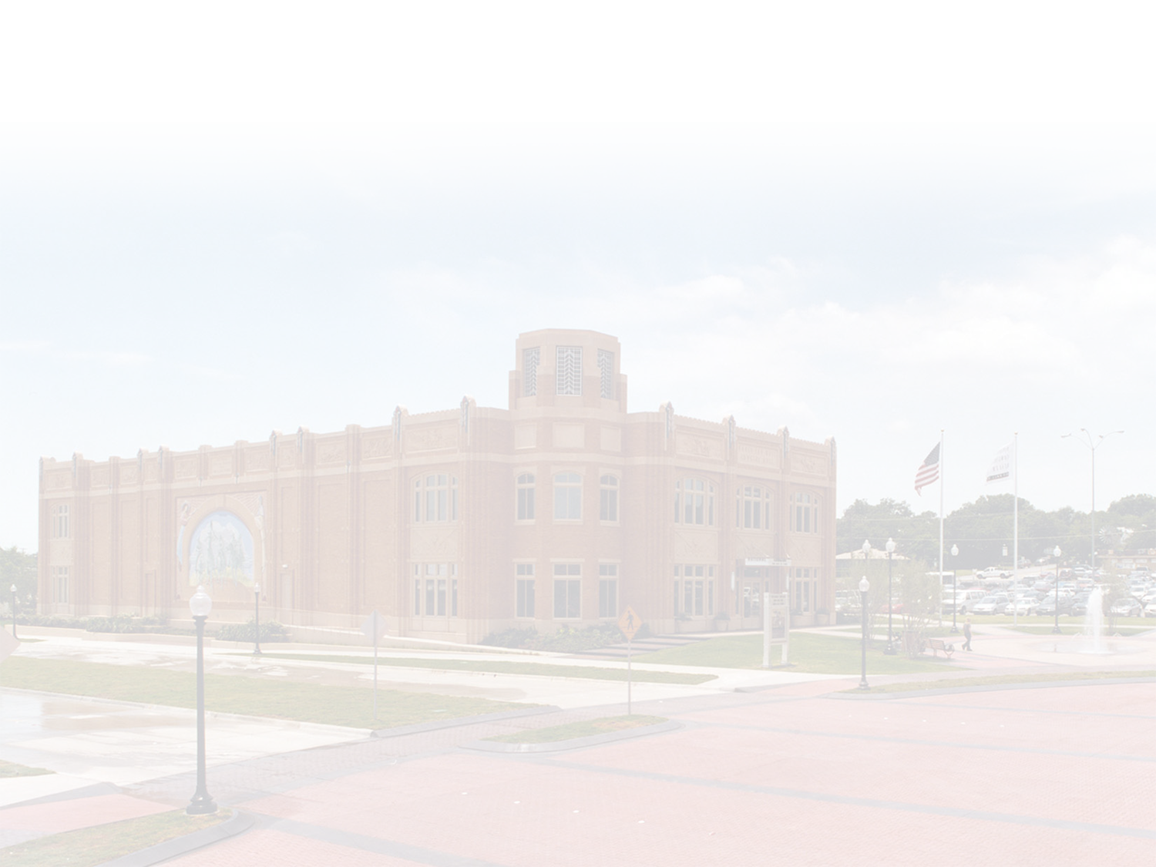
Fort Worth Cultural District
Amon Carter Museum 3501 Camp Bowie Blvd. (817) 738-1933 www.cartermuseum.org
Botanic Garden/Japanese Garden 3220 Botanic Garden Blvd. (817) 871-7689 www.fwbg.org
Casa Mañana 3101 West Lancaster Avenue (817) 332-2272 www.casamanana.org
Fort Worth Museum of Science and History 1501 Montgomery Street (817) 255-9300 fortworthmuseum.org
Kimbell Art Museum 3333 Camp Bowie Blvd. (817) 332-8451 www.kimbellart.org
Modern Art Museum of Fort Worth 3200 Darnell Street (817) 738-9215 www.mamfw.org
National Cowgirl Museum and Hall of Fame 1720 Gendy Street (817) 336-4475 www.cowgirl.net
Will Rogers Memorial Center 3401 Lancaster Avenue (817) 871-8150 www.fwculture.com/wrogers.htm
Map of Fort Worth Cultural District

Slide 12

Downtown Fort Worth
Bass Performance Hall 525 Commerce Street (817) 212-4200 www.basshall.com
Cattle Raisers Museum 1301 West 7th Street (817) 332-8551 www.cattleraisersmuseum.org
Fort Worth Convention Center 1201 Houston Street (817) 570-2222 www.fortworth.com
Central Library 500 W. 3rd Street (817) 871-7701 www.fortworthlibrary.org
Milan Art Gallery 525 Commerce Street (817) 212-4200 www.milangallery.com
Sid Richardson Museum 309 Main Street (817) 332-655 www.sidrmuseum.org
Sundance Square (817) 255-5700 www.sundancesquare.com
Water Gardens 1502 Commerce Street (817) 871-5757 www.fortworth.com/watergardens
Map of Downtown Fort Worth

Slide 13

Fort Worth Historic Stockyards
Billy’s Bob’s Texas 2520 Rodeo Plaza 817 624-7117 www.billybobstexas.com
Cowtown Coliseum 121 E. Exchange Avenue 817 625-1025 www.cowtowncoliseum.com
Livestock Exchange 121 E. Exchange Avenue
H3 Ranch 109 E. Exchange Ave 817-624-1246 www.h3ranch.com
Stockyards Station 140 E. Exchange Avenue 817-625-9715 www.stockyardsstation.com
Tarantula Train Depot 140 E. Exchange Avenue 817-625-7245 www.stockyardsstation.com/tarantulatrain
White Elephant Saloon 106 E. Exchange Avenue 817-624-1887 www.whiteelephantsaloon.com
Map of Fort Worth Historic Stockyards

Slide 14
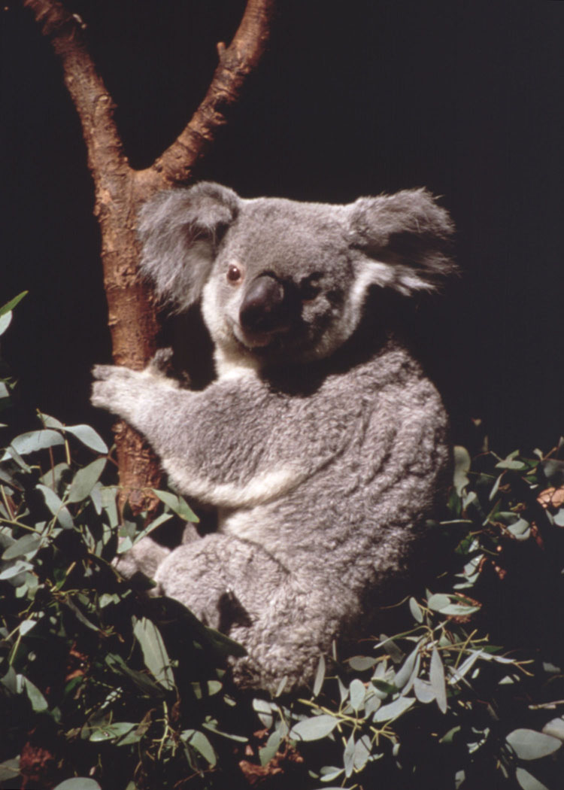
Fort Worth Parks, Gardens and Zoo
Botanic Garden, Japanese Garden and Conservatory 3220 Botanic Garden Blvd. (817) 871-7689 www.fwbg.org
Fort Worth Zoo 1989 Colonial Parkway (817) 759-7555 www.fortworthzoo.com
Log Cabin Village 2100 Log Cabin Village Lane (817) 926-5881 www.logcabinvillage.org
Map of Fort Worth Parks, Gardens and Zoo

Slide 15
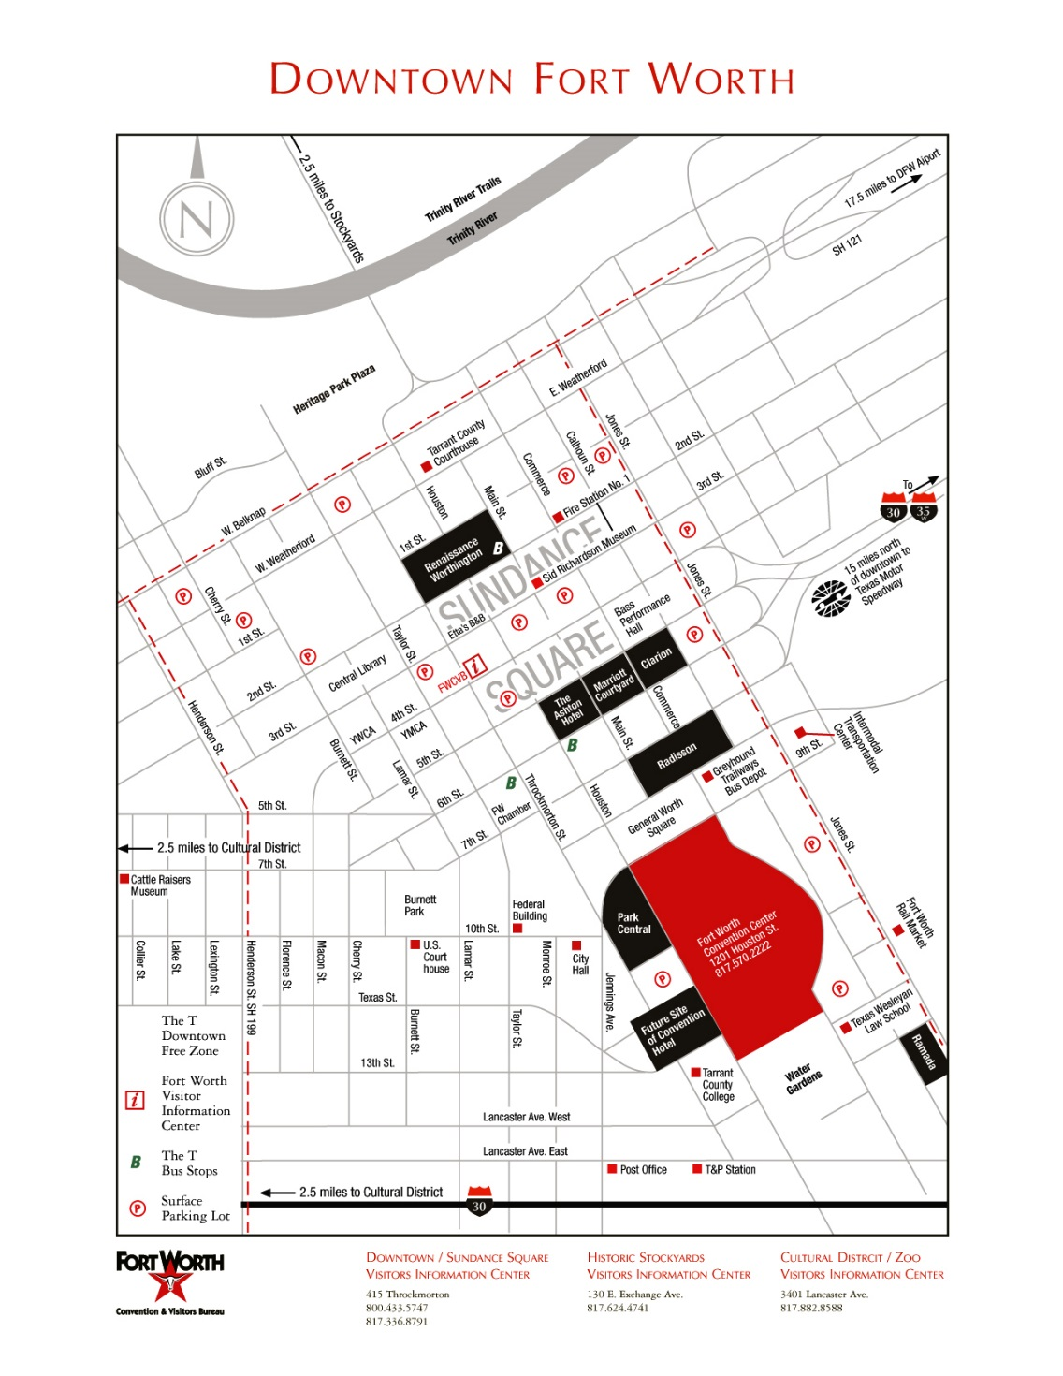

Slide 16
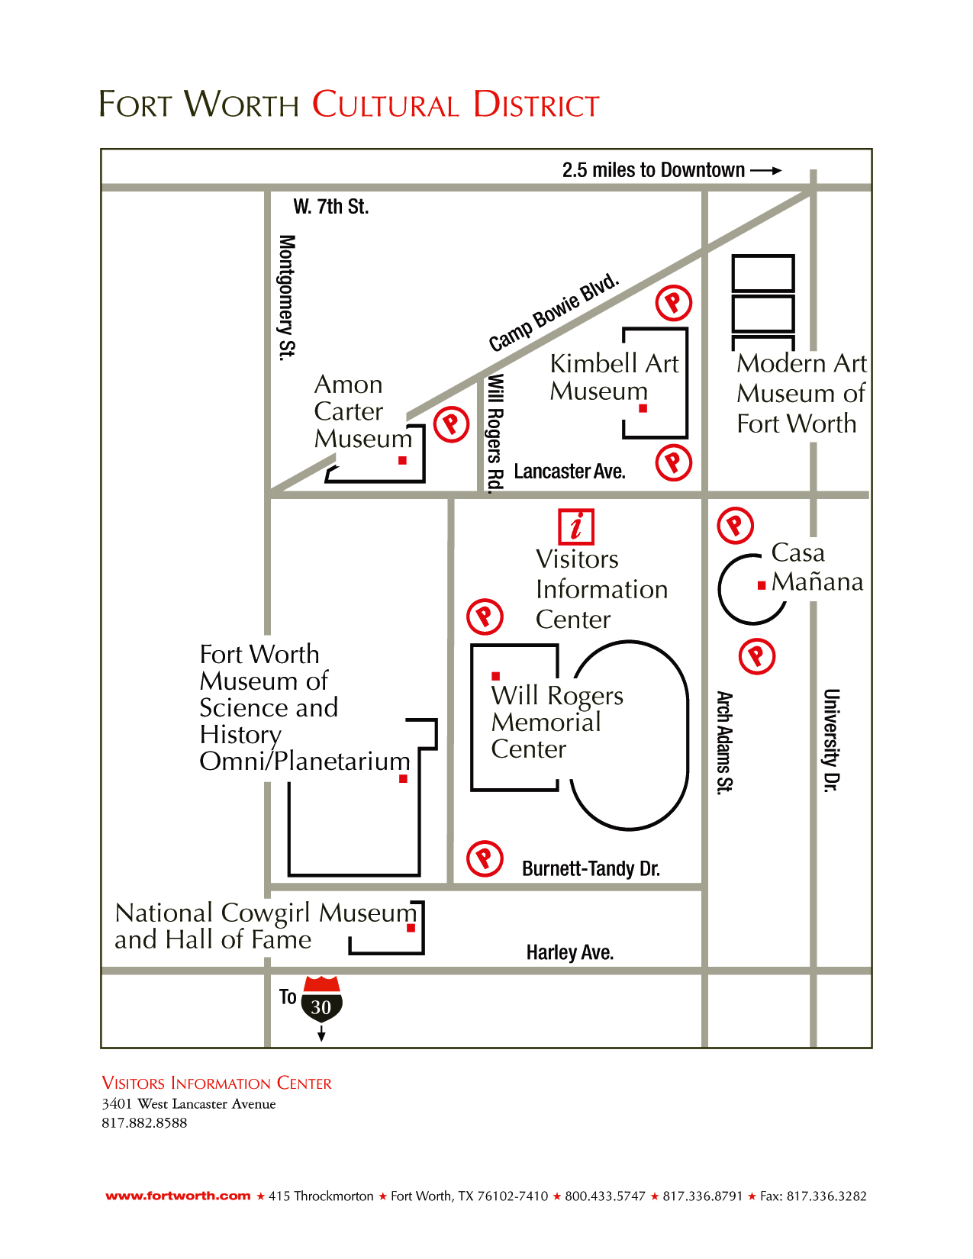

Slide 17
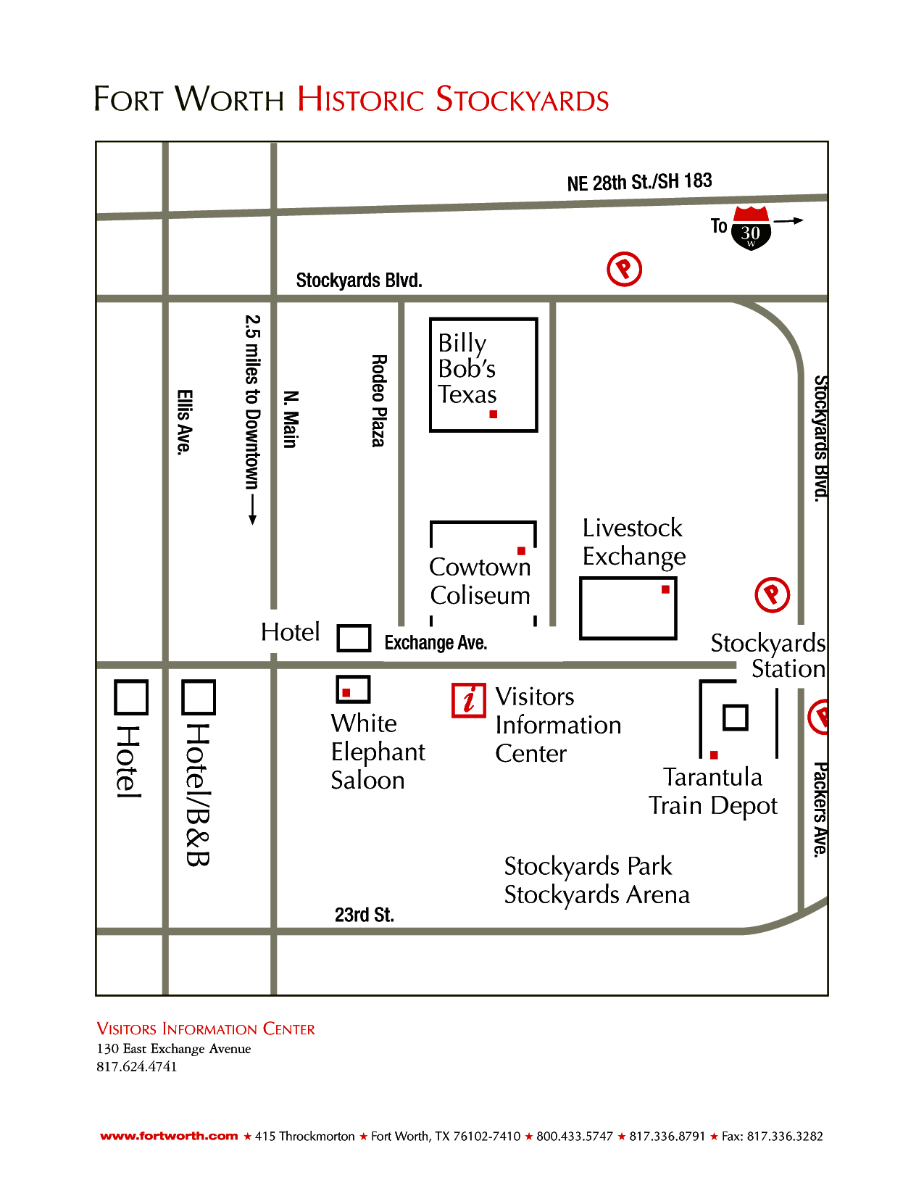

Slide 18
