Slide 1
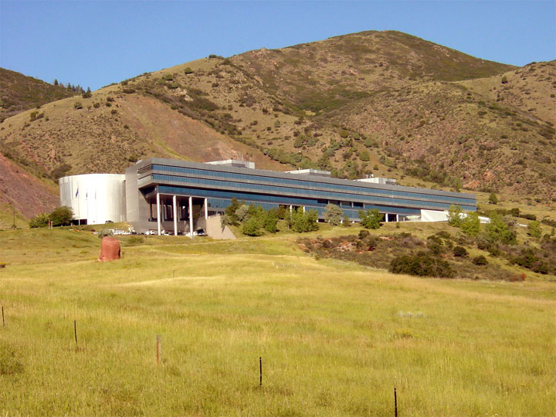
Lockheed Martin
Deer Creek Facility
12999 W Deer Creek Canyon Rd
Littleton, CO 80127

Slide 2
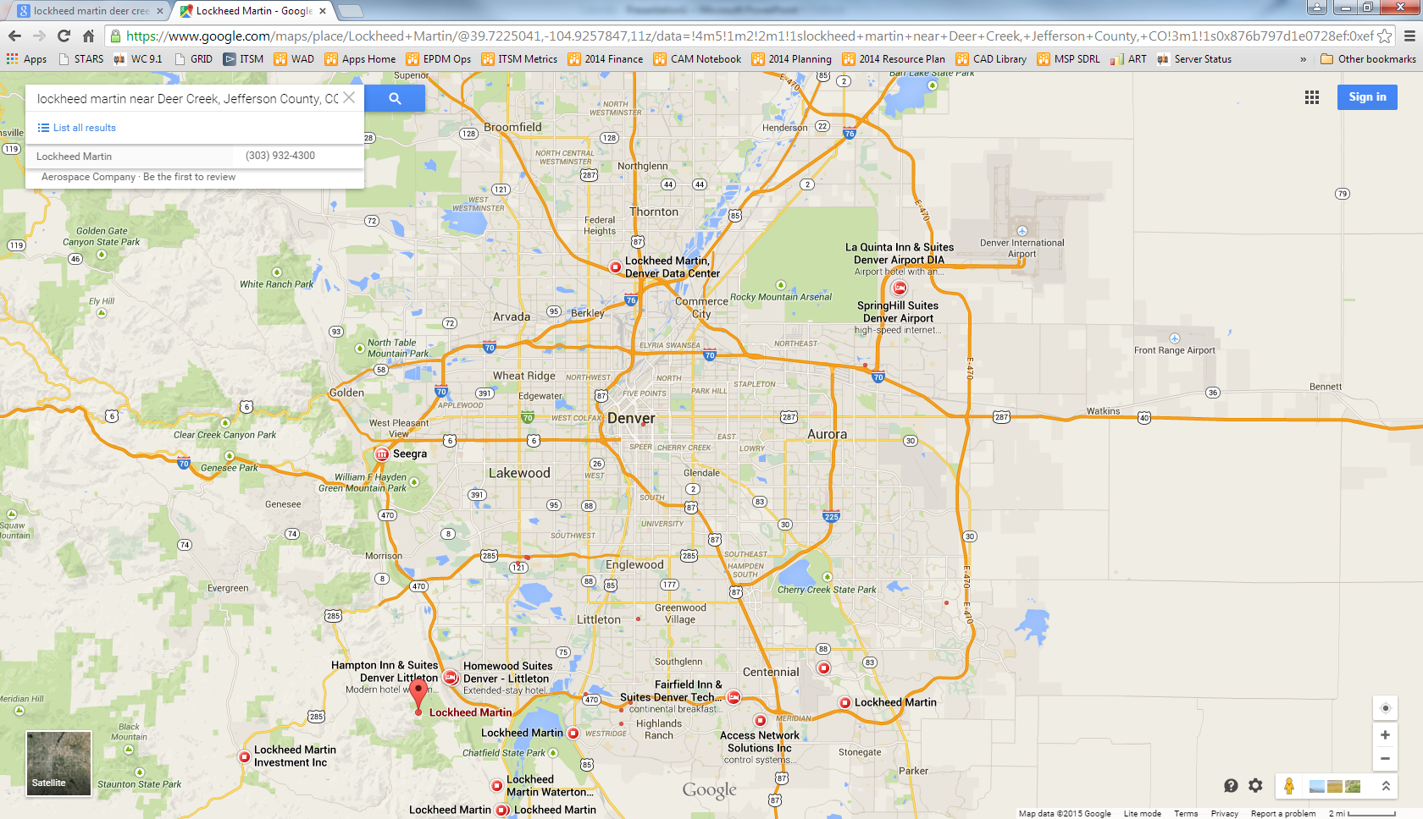

Slide 3
