Slide 1
Visitor Information
Lockheed Martin Dallas Facility

Slide 2
Arriving at Lockheed Martin
Thayer Building Main Entrance at Thayer Circle
1902 W. Freeway, Grand Prairie 75051
The security officers will instruct you where to park and where to enter the building
Have government issued photo ID (driver’s license, passport, etc.) ready for inspection by security officers in Thayer Lobby
Restricted Items
Cameras
Mobile phones
Recording devices
Digital watches that can connect to the internet
E-readers
Flash drives or other storage devices
Lost?
Call the lobby desk at (972) 603-7914 or the Code Quest hotline at (469) 516-4796
Hotline will only be answered on April 21

Slide 3
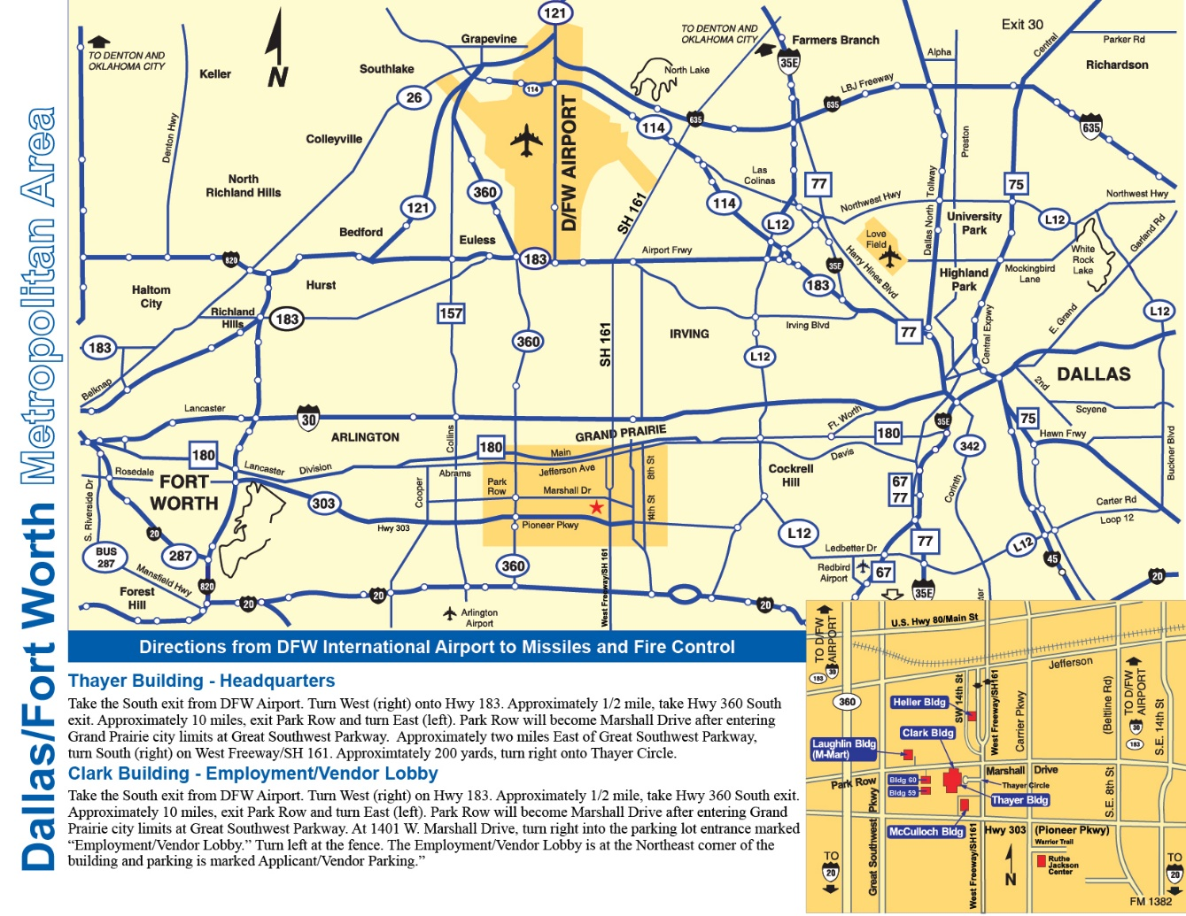
Map & Directions to Lockheed Martin
Thayer Lobby address:
1902 W. Freeway (161 access road), Grand Prairie, TX 75051
Visitor parking available at Thayer Circle off of W. Freeway
Directions from D/FW Airport to Thayer Lobby:
Via Highway 360
Follow signs for south exit out of the airport. Turn right (west) onto Highway 183. In approximately 1/2 mile take Highway 360 South exit.
In approximately nine miles exit Park Row and turn left (east). Park Row will become Marshall Drive after crossing Grand Prairie city limit at Great Southwest Parkway. Turn right (south) onto SH-161 frontage road. In approximately 200 yards take first right onto Thayer Circle.
Via State Highway 161/President George Bush Turnpike (Toll Road)
Follow signs for south exit out of the airport. Keep left at the fork and follow signs for TX-183 East/Irving/Dallas and merge onto TX-183 East. Take the exit onto TX-161 South (partial toll road). Continue onto President George Bush Turnpike South.
In approximately eight miles exit Marshall Drive. Proceed south on the frontage road and turn right onto Thayer Circle.

Slide 4
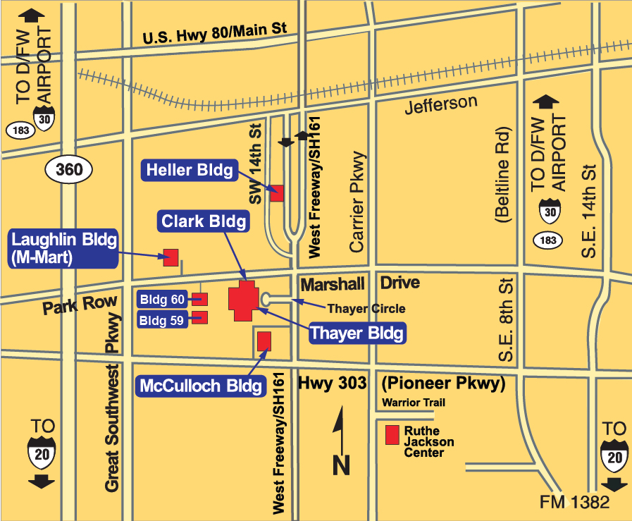
Facility Map
Thayer Building address:
1902 W. Freeway (Southbound 161 access road), Grand Prairie, TX 75051
Visitor parking available at Thayer Circle off of W. Freeway

Slide 5
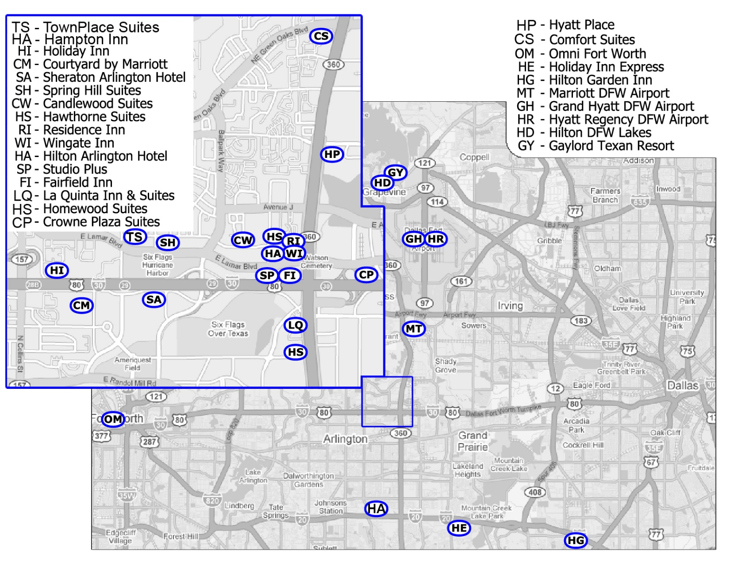
Local Hotel Map

Slide 6
Local Hotels
(SP) Studio Plus 2420 E. Lamar Blvd, Arlington (817) 607-4500 www.freehotelsearch.com
(HS) Homewood Suites 2401 E. Road to Six Flags, Arlington (817) 633-1594 www.homewoodsuites.com
(HR) Hyatt Regency DFW Airport DFW Airport, TX 75261 (972) 615-6719 www.grandhyattdfw.com
(OM) Omni Fort Worth 1300 Houston Street, Fort Worth (817) 535-6664 www.omnihotels.com
(CS) Comfort Suites 2075 N. Hwy 360, Grand Prairie (817) 633-6311 www.choicehotels.com
(FI) Fairfield Inn 2500 E. Lamar Blvd, Arlington (817) 649-5800 www.marriott.com
(CP) Crowne Plaza Suites 700 Avenue H East, Arlington (817) 640-0440 www.crowneplaza.com
(HG) Hilton Garden Inn 800 N. Main Street, Duncanville (972) 283-9777 www.hiltongardeninn3.hilton.com
(HE) Holiday Inn Express 4112 S. Carrier Pkwy, Grand Prairie (972) 264-4002 www.hiexpress.com
(HD) Hilton DFW Lakes 1800 Highway 26 East, Grapevine (817) 481-8444 www.dfwlakes.hilton.com
(LQ) La Quinta Inn & Suites 825 N. Watson Rd, Arlington (817) 640-4142 www.lq.com
(GH) Grand Hyatt DFW Airport 2337 S. International Pkwy (972) 973-1234 www.grandhyattdfw.com
(MI) Marriott- DFW Airport S 4151 Centerport Dr., Fort Worth (817) 358-1700 www.marriott.com
(HP) Hyatt Place 1542 N Hwy 360, Grand Prairie (972) 988-6800 www.hyattplace.com
(GY) Gaylord Texan Resort 1501 Gaylord Trail (817) 778-1000 www.gaylordtexan.com

Slide 7
Local Hotels - CONTINUED
(TS) Townplace Suites 1709 E Lamar Blvd, Arlington (817) 861-8728 www.marriott.com
(HA) Hampton Inn 1100 E I-20, Arlington (817) 419-3700 www.hamptoninn3.hilton.com
(HI) Holiday Inn 1311 Wet N Wild Way, Arlington (817) 460-2500 www.hiarlingtontx.com
(CM) Courtyard by Marriott 1500 Nolan Ryan Exprwy, Arlington www.marriott.com
(SA) Sheraton Arlington Hotel 1500 Convention Center Dr. (817) 261-8200 www.sheratonarlingtontx.com
(SH) Spring Hill Suites 1975 E Lamar Blvd, Arlington (817) 860-2737 www.marriott.com
(CW) Candlewood Suites 2221 Brookhollow Plaza Dr, Arlington (817) 649-3336 www.ichotelsgroup.com
(HS) Hawthorn Suites 2401 Brookhollow Plaza Dr, Arlington (817) 640-1188 www.wyndhamhotels.com/hawthorn
(RI) Residence Inn 1050 Brookhollow Plaza Dr, Arlington (817) 649-7300 www.marriott.com
(WI) Wingate Inn 1024 Brookhollow Plaza Dr, Arlington (817) 640-8686 www.wingateinns.com
(HA) Hilton Arlington Hotel 2401 E Lamar Blvd, Arlington (817) 640-3322 www.hilton.com

Slide 8
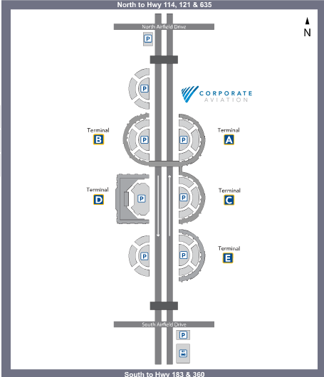
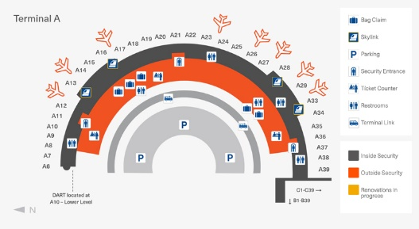
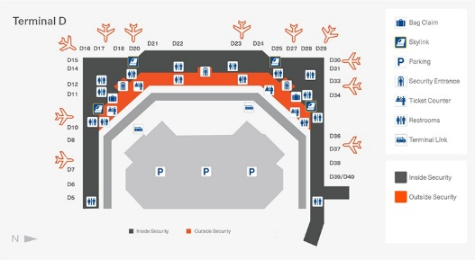
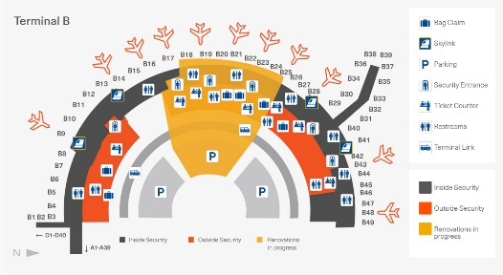
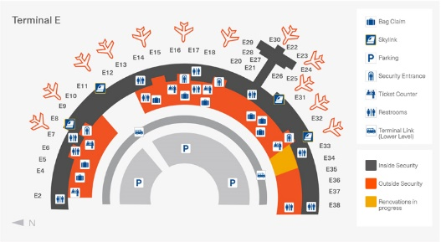
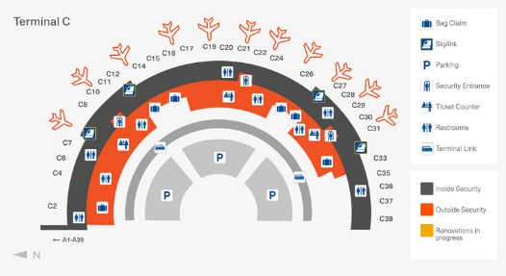
Airline Flight Information
American Airlines www.aa.com DFW: (817) 267-2222 Toll Free: 1 (800) 223-5436
Delta Airlines www.delta.com DFW: (817) 630-3200 Toll Free: 1 (800) 221-1212
United Airlines www.united.com Toll Free: 1 (800) 241-6522
DFW Airport

Slide 9
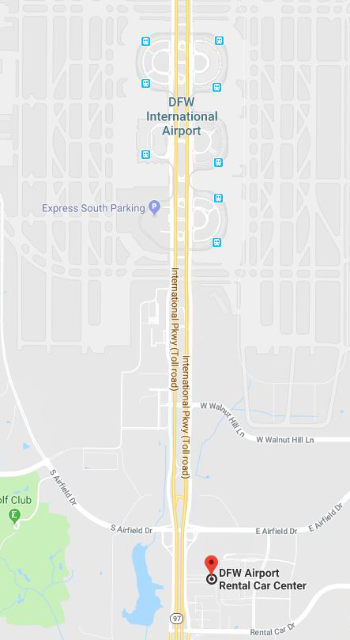
Car Rental – D/FW Airport

