Slide 1
Lockheed Martin TLS
Visitor Maps & Directions
Orlando, FL

Slide 2
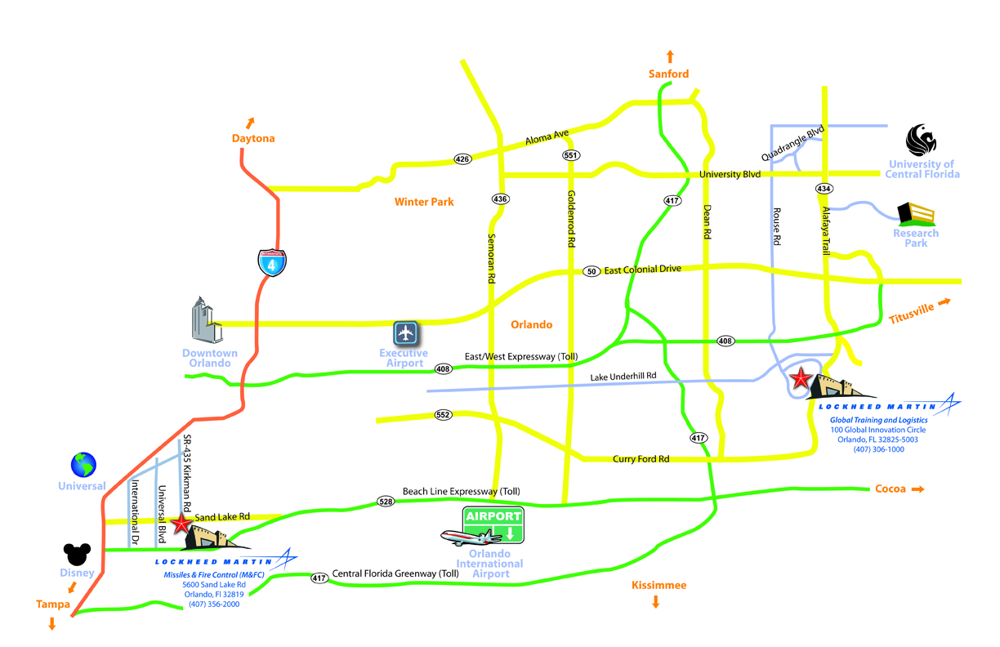
Orlando Metro Area
Training and Logistics Solutions
100 Global Innovation Circle
Orlando, FL 32825-5003
(407) 306-1000

Slide 3
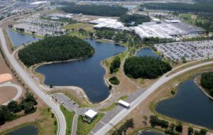
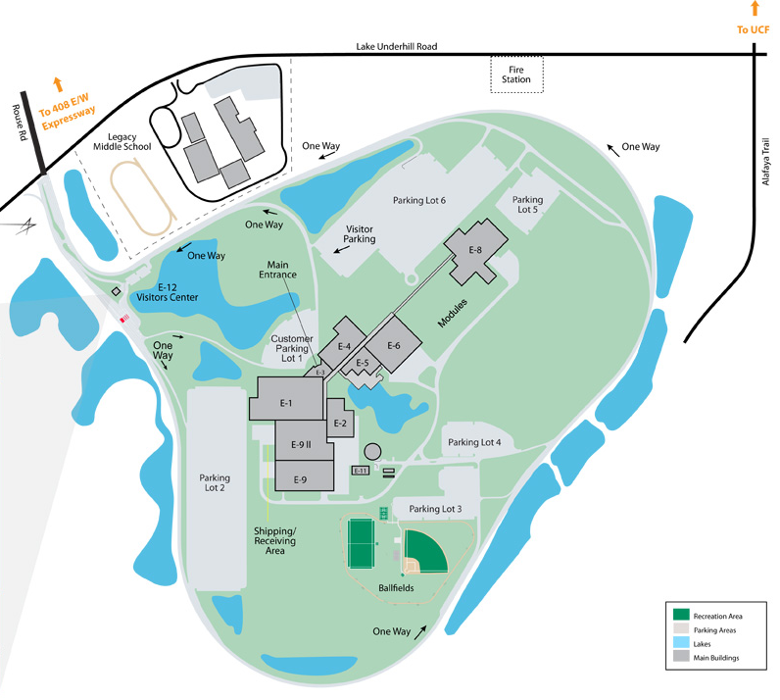
Global Innovation Campus
Drive onto Lockheed Martin Facility at Rouse Rd & Lake Underhill
Enter the “Vehicle Plaza” at any of the open lanes.
Stop & Check in with Security Guard who will grant you access to the facility.
Parking - Follow road on the LEFT for Parking Lot #1.
Enter the “Vehicle Plaza” at Any of the open lanes

