Slide 1
Lockheed Martin Code Quest® 2018
King of Prussia Visitor Packet
Maps and directions are on the following charts
  Buses may drop off, or park and wait. Bus drivers must remain with their vehicle at all times while on site.
Requirements for Entry into the Lockheed Martin Building
  Only registered students and coaches will be admitted. No parents or siblings. Alternates will only be admitted if they are replacing a primary team member and were pre-registered and submitted a signed photo release.
  For U.S. citizens, a government issued photo I.D. will be required for anyone over 18. School IDs are acceptable for students under 18.
  For non-U.S. citizens, a valid passport is required. Please do NOT forget your passport.
Competition Equipment and Rules
  Each team is allowed to bring one computer to the competition. You may bring an external monitor, but table space is limited, so 23” or less is recommended.
  Each team may bring one textbook to the competition for reference.
  Printers are not allowed.
  NOTE - Cell phones, digital watches, e-readers and broadband network cards are NOT allowed during the Code Quest competition. If you are observed using any of these devices, your team is subject to immediate disqualification.
  UNDER NO CIRCUMSTANCES are ANY phones or recording devices allowed inside the facility. Please leave ALL phones in your cars. The following number can be given to family and friends in case of an emergency (610-531-5555).

Slide 2
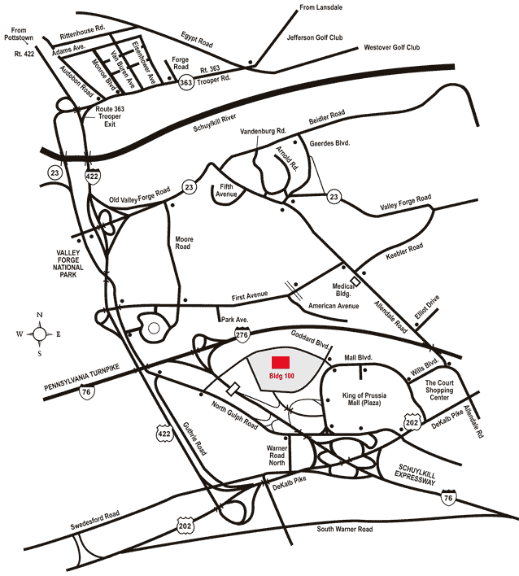
Lockheed Martin – Building 100
230 Mall Blvd, King of Prussia, PA 19406
Google Maps Link

Slide 3
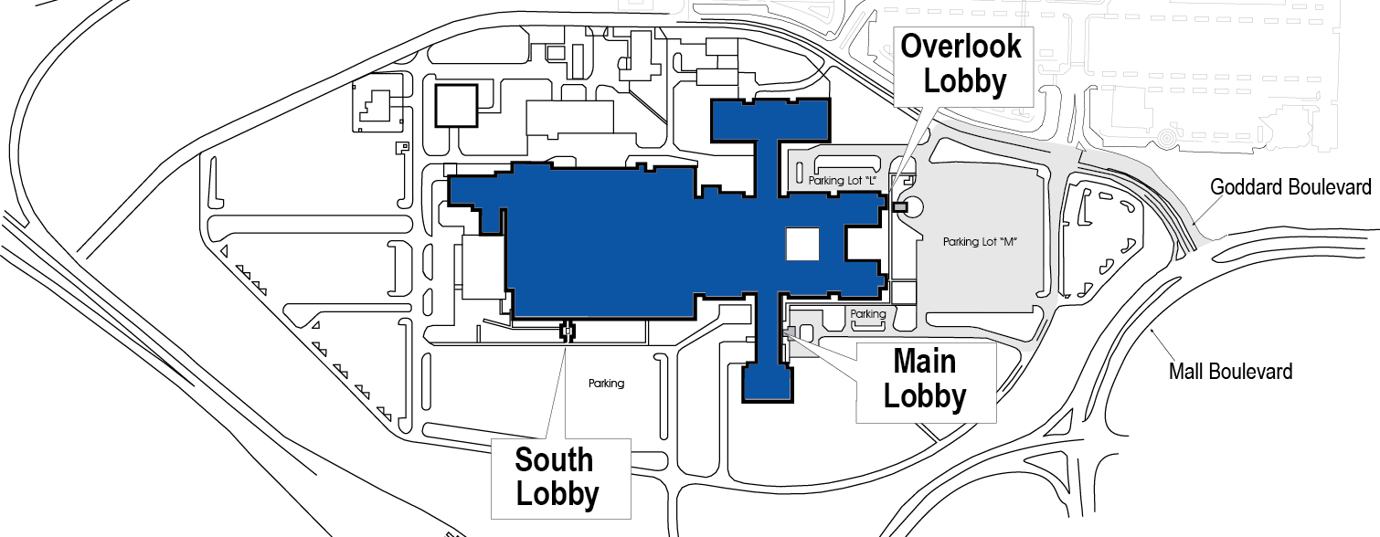
Lockheed Martin – Building 100
230 Mall Blvd, King of Prussia, PA 19406
Talent Acquisition Center
Goddard Boulevard
Bus Parking
North Gulf Road
Code Quest® Participants
From Mall Blvd: Turn onto Goddard Blvd. Go past the light at Conrad Dr. and make the first left into the Lockheed Martin Building 100 lot.
From North Gulf Road: Turn onto Goddard Blvd. Make the fifth right into the Lockheed Martin Building 100 lot. (third right is gated)
Cars: Park in Lot “M” or Lot “L” and proceed to the Talent Acquisition Center entrance.
Buses: may drop off, or park and wait. Bus drivers must remain with their vehicle at all times while on site. Buses park in back of Lot “M”

