Slide 1
Visitor Information
Lockheed Martin Space Houston facility

Slide 2
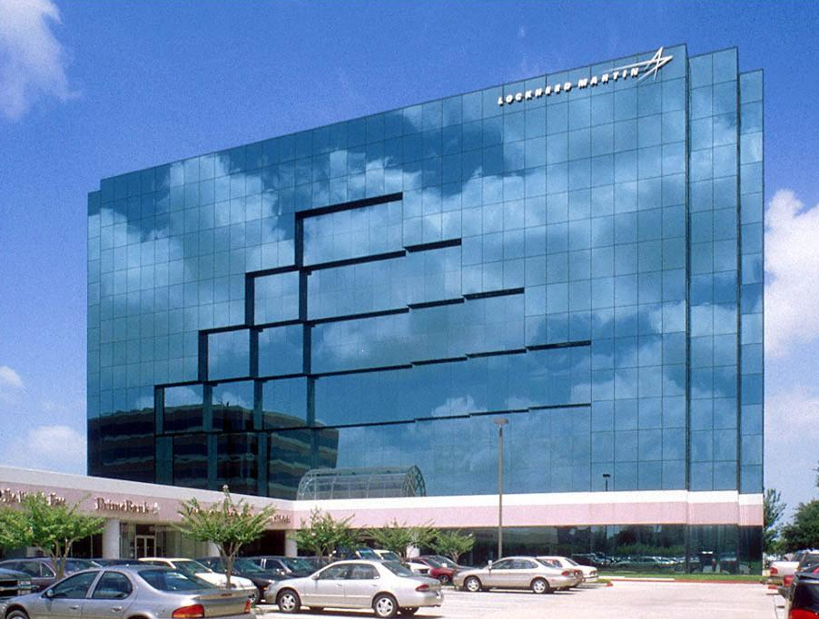
Arriving at Lockheed Martin
2625 Bay Area Blvd. Suite 160 Houston, TX 77058
Please park in the parking garage off Falcon Pass.
Have government issued photo ID (driver’s license, passport, etc.) ready for inspection by security in building lobby.
Restricted Items
Flash drives or other storage devices
Lost?
Call the OCC lobby desk at: 281-283-4267
Lobby Desk will only be answered on April 27th

Slide 3
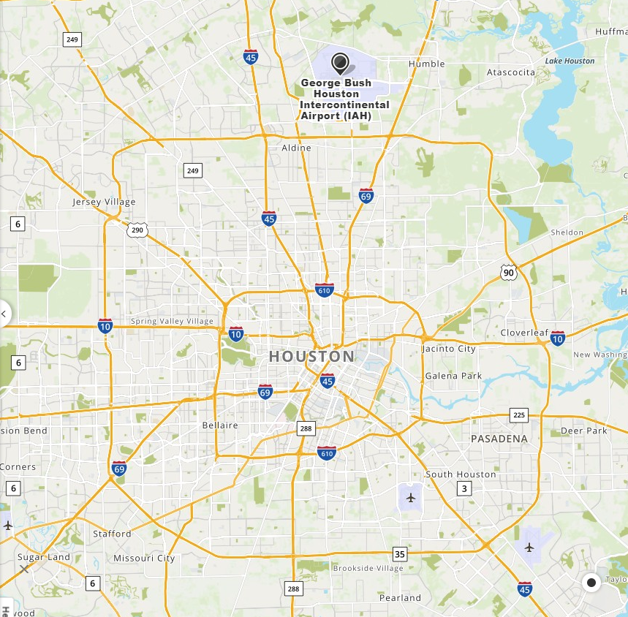
Map & Directions to Lockheed Martin
Orion Conference Center (OCC):
2625 Bay Area Blvd, Suite 160 Houston, TX 77058
Park in the Rear Parking Garage DO NOT PARK in front of building (Retail stores and 30 minute parking only)
Directions from IAH (Bush) Airport to OCC:
Start out going west on Jetero Blvd/Will Clayton Pkwy and continue to Will Clayton Pkwy until you see signs for US 59 S/I-69 towards Houston. Use the left lane to take the US 59S/I-69 ramp. Merge onto I-69 and in 16.8 miles take the exit toward Galveston I-45S. Continue on I-45 S for approximately 15.5 miles and take exit 29 toward Farm to Market 2351/Clear Lake City Blvd/Friendswood. Use the left 2 lanes to turn left onto FM 2351 E and continue onto Clear Lake City Blvd for 1.5 miles. Turn right onto Space Center Blvd and in 2.1 miles turn left onto Falcon Pass. This will take you directly to the parking garage in the back of the building. The parking garage is on the right hand side directly across the street from the high school track and soccer fields.
Directions from Hobby Airport to OCC:
Take the exit to Airport Blvd from Hobby Airport Loop. Take slight right onto Airport Blvd and continue for 1.6 miles and turn right onto Gulf Fwy (45S). Use the left lane to take I 45S. Continue on I-45S for 5.5. miles and take exit 29 for Farm to Market 2351 and continue onto Clear Lake City Blvd for 1.5 miles. Turn right onto Space Center Blvd and in 2.1 miles turn left onto Falcon Pass. This will take you directly to the parking garage in the back of the building. The parking garage is on the right hand side directly across the street from the high school track and soccer fields.
Welcome to Houston
Hobby Airport
Lockheed Martin

Slide 4
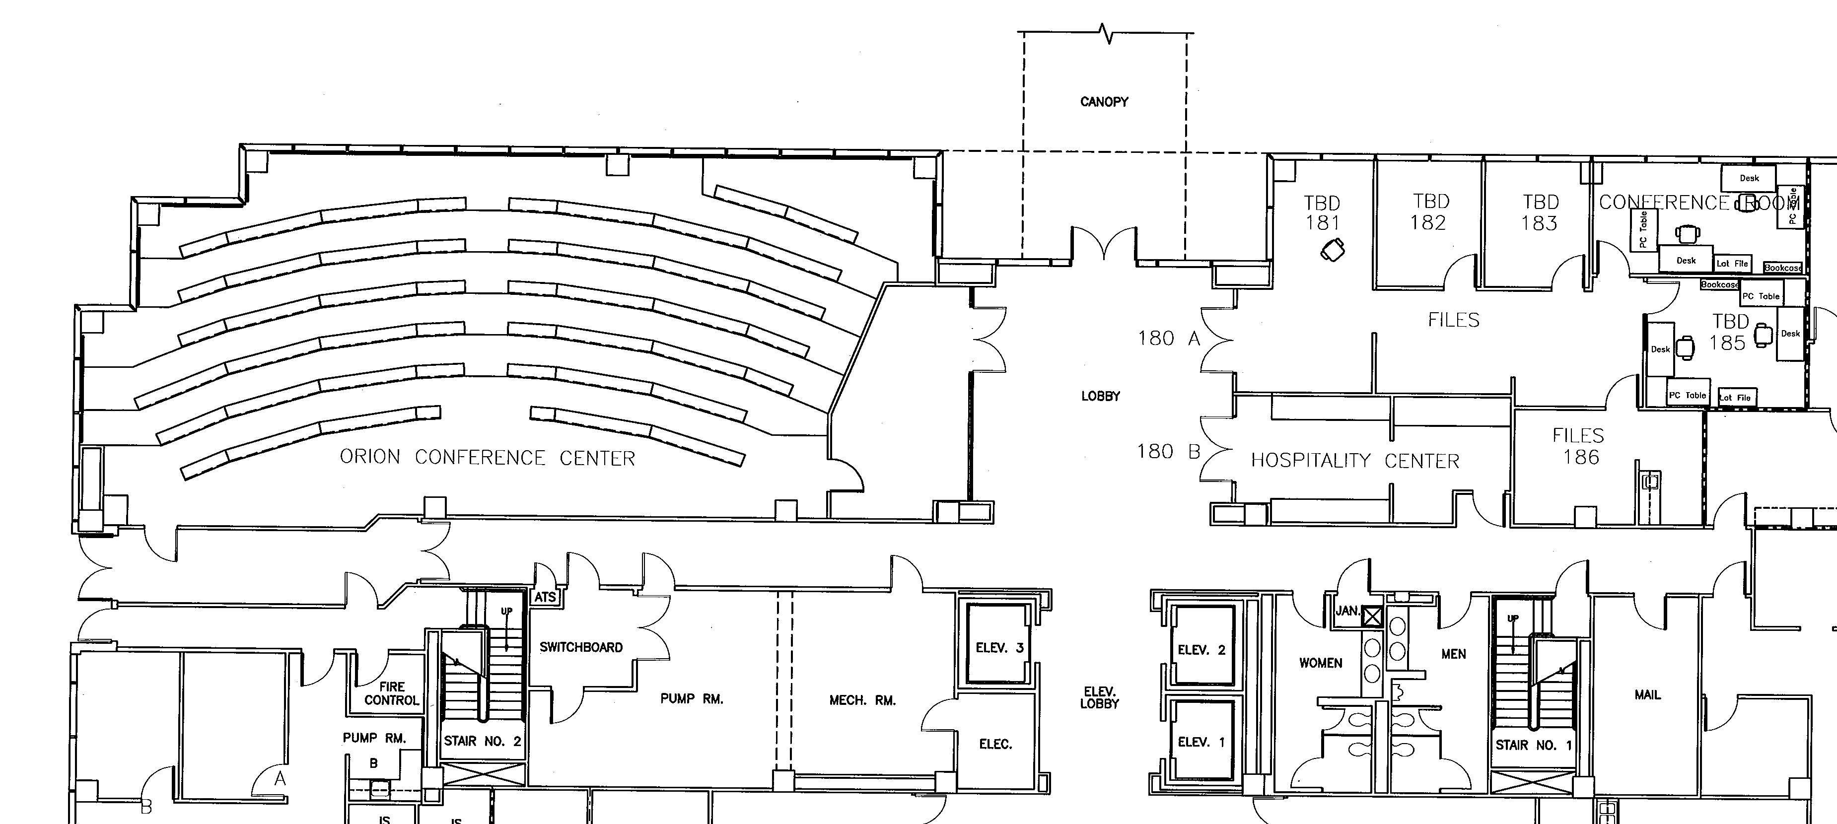
Falcon Pass
Facility Map
Parking Garage
Orion Conference Center (OCC)
2625 Bay Area Blvd. Suite 160
Houston, TX 77058
Parking available in the parking garage off Falcon Pass
OCC
OCC Kitchen
Restrooms
Vending
Machines

Slide 5
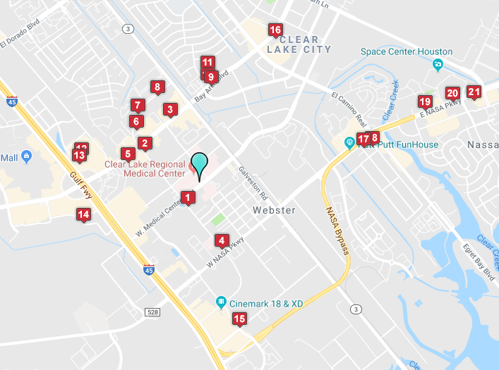
Local Hotel Map
1. Hilton Garden Inn Webster
2. Comfort Suites Webster
3. Holiday Inn Webster
4. Days Inn Webster
5. Best Western Webster Hotel
6. La Quinta Inn & Suites Webster
7. Home2 Suites by Hilton Webster
8. Staybridge Suites Webster
9. Hampton Inn & Suites Clear Lake
10. Homewood Suites by Hilton Clear Lake
11. Sonesta ES Suites NASA Clear Lake Houston
12. Extended Stay America Hotel NASA ebster
13. Holiday Inn Express Hotel & Suites Webster
14. Tru by Hilton Hotel Webster
SpringHill Suites by Marriott Webster
TownePlace Suites by Marriott Clear Lake Houston

Slide 6
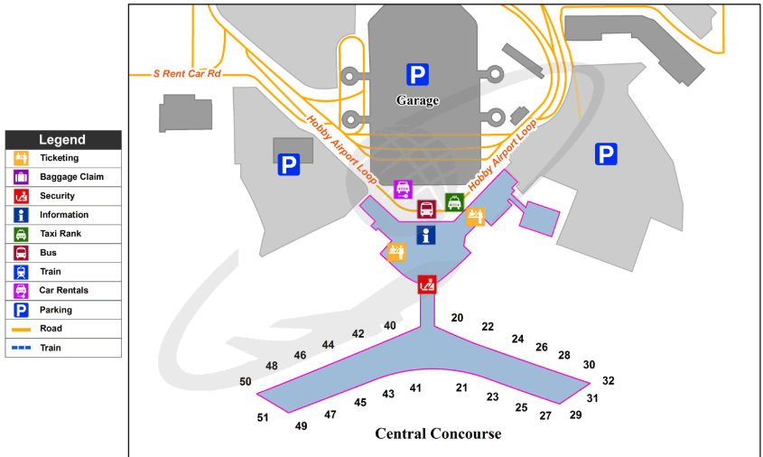
Hobby Airport Airline Flight Information
Hobby is the closest airport to the facility
Hobby Airport
Southwest Airlines www.southwest.com Toll Free: 1 (800)435-9792 American Airlines www.aa.com Toll Free: 1 (800) 223-5436 Delta Airlines www.delta.com Toll Free: 1 (800) 221-1212 United Airlines www.united.com Toll Free: 1 (800) 241-6522

Slide 7






Car Rental – Hobby airport

