Slide 1
Lockheed martin greenville
visitor information

Slide 2
General information
Facility Address: 244 Terminal Road, Greenville, SC 29605
Closed, flat-toe shoes are recommended for site tour.
All Visitors must Process through the Visitor Center upon Arrival
All visitors will be issued visitor badges that must be worn above the waist.
All visitors must possess some type of government-issued identification (i.e. drivers license, passport, etc.).
Visitors requiring drive-on access to the facility will be issued a temporary drive-on pass which must be prominently displayed when entering the facility, during visit and exiting the facility.
No Foreign Nationals allowed on the facility without prior visit authorization.
Items Restricted from the Facility
Cameras of any kind; however, cameras on cell phones are permitted on the site but cannot be used.
Electronic devices capable of recording
Alcohol
Smoking and/or usage of any tobacco products (i.e. chewing tobacco, packets, etc.)
All Weapons

Slide 3
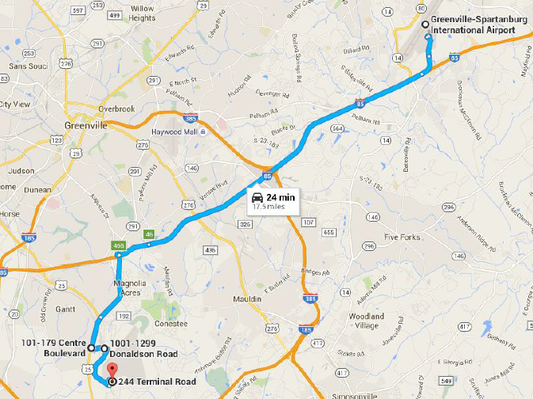
Directions to facility from gsp airport
Follow airport signs to exit on I-85 South
Take exit 46B: SC-291/Mauldin Rd./Pleasantburg Dr./Augusta Rd.
Drive south on Hwy. 291/US-25 BR towards Greenwood for 3 miles
Turn LEFT onto AD Asbury Dr. towards Donaldson Rd.
Proceed onto AD Asbury Dr. to the main entrance of the South Carolina Technology and Aviation Center (SCTAC). Proceed STRAIGHT to SCTAC.
At the stop sign, turn RIGHT onto Perimeter Road.
Continue on Perimeter Road until you arrive at Lockheed Martin, turn LEFT.
As you approach the security gate, turn RIGHT just before the gate. At the stop sign, turn LEFT towards the Visitor Center.

Slide 4
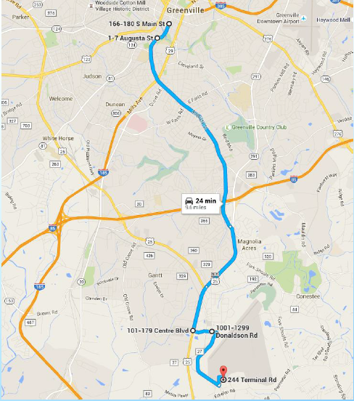
Directions to facility from downtown
Head south on Main St.
At the intersection of River St., veer LEFT onto Augusta St.
Stay south on August Rd for 7 miles
Turn LEFT onto AD Asbury Dr. towards Donaldson Rd.
Proceed onto AD Asbury Dr. to the main entrance of the South Carolina Technology and Aviation Center (SCTAC). Proceed STRAIGHT to SCTAC.
At the stop sign, turn RIGHT onto Perimeter Road.
Continue on Perimeter Road until you arrive at Lockheed Martin, turn LEFT.
As you approach the security gate, turn RIGHT just before the gate. At the stop sign, turn LEFT towards the Visitor Center.

Slide 5
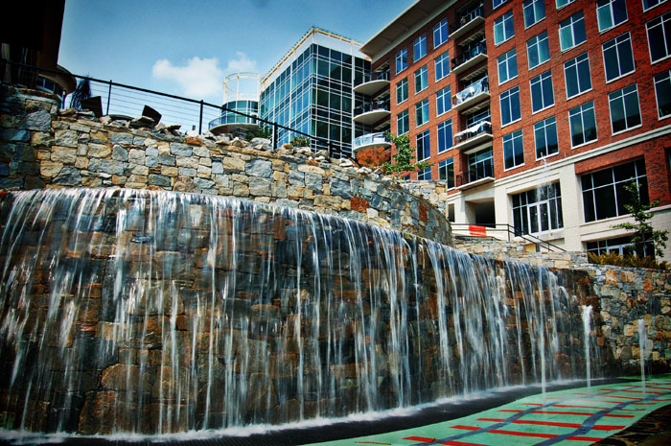
Recommended hotels
Lockheed Per Diem Negotiated Hotels
Aloft Hotel Downtown (~25 min. drive from site)
Crowne Plaza (~20 mins)
Hyatt Place Haywood (~20 mins)
Drury Inn & Suites (~20 mins)
Wyndam Garden Airport (~25 mins)
Candlewood Suites (~20 mins)
Hotels Downtown (non Per Diem rate)
Courtyard by Marriott
Hampton Inn and Suites by Hilton
Hyatt Regency Greenville
Embassy Suites by Hilton
The Westin Poinsett
Home 2 Suites by Hilton

Slide 6
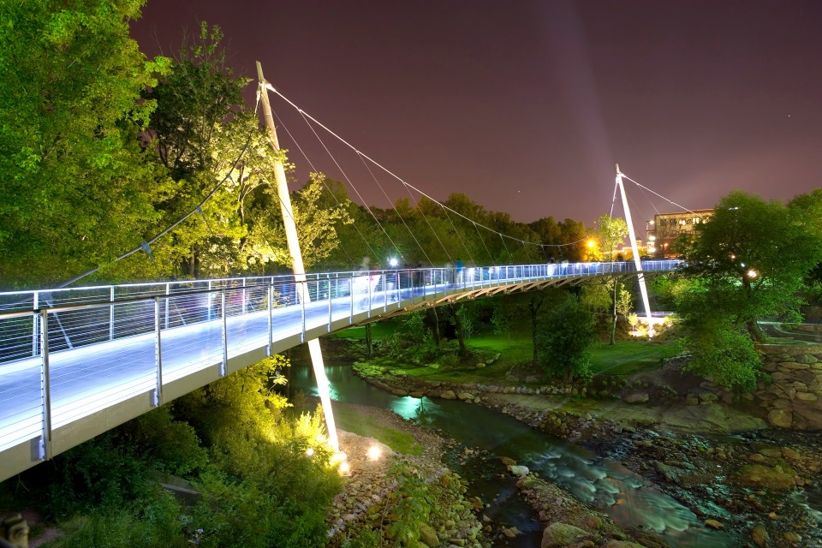
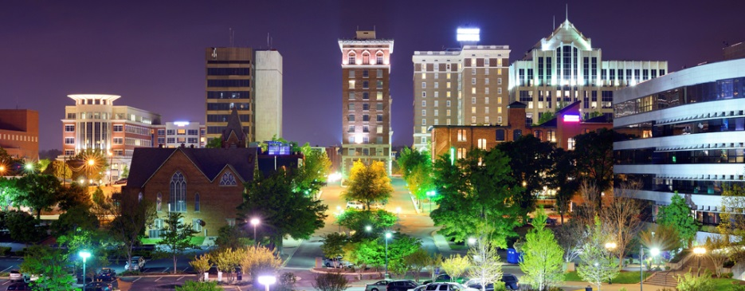
Downtown restaurants and attractions
Recommended Restaurants
Rick Erwin’s Nantucket Grill
Rick Erwin’s West End Grill
Larkin’s on the River
Soby’s New South Cuisine
Hall’s Chophouse
Other Attractions
Jack N Diane’s – Dueling Piano Bar
Blues Boulevard Jazz
Alchemy Comedy Theater
Falls Park on the Reedy
Liberty Bridge at Fall Park on the Reedy
Stellar Wine Bar
Trappe Door
Additional Resources

