Slide 1


Hercules Training Center 86 South Cobb Drive, Building B-68 Marietta, GA 30063

Slide 2
Introduction
Welcome to the Hercules Training Center (HTC) in Marietta, Georgia. Our goal at the HTC is to provide you the best training experience. Your course syllabus is part of your gradebook and will give you the big picture on your training. Your weekly training schedule will be published and available to you but the schedule is subject to change based on factors that are not controllable such as training device maintenance, student training issues and weather delays or cancellations.
Safety is our first priority whether on or off duty. We ask that you come prepared for training every day and if you have any issues or concerns, that you bring them to the attention of your instructor, the Chief Instructor, the Training Administrator and the Student Services Representative before they affect your training.

Slide 3
Important Contact Information
Business Office Hours of Operations 0700-1600
Training Center Manager, Duke Bender 501-259-6456
Chief Instructor, Dale Pattyn 770-494-3171
Maintenance Lead Instructor,
Vernon Watkins (Airframes/Avionics) 770-494-3051
Chad Yanich (Propulsion/Electrical) 770-793-1196
Kevin Keller (Avionics/Electrical) 770-793-2091
Training Administrator, Rachel Doll 501-259-2623
Lockheed Security 770-494-3244
on site (4-3244)
HTC Email herculestrainingcenter.gr-rms@lmco.com

Slide 4
General Information
The training week is Monday through Friday with Saturday used as a schedule make up day if required. It is vital that you follow your training schedule every day. Your training events are hard scheduled based on resource availability and cannot be adjusted to accommodate personal schedules. The HTC trains many students at a time with different requirements with the same training resources so if you cannot attend your scheduled event due to illness or emergency please contact the Training Administrator or Student Services Representative at least 1 hour before your required event is scheduled to begin, if possible. If it is before or after business office hours, leave a detailed message with your name, phone number, the issue, and your class number. Your safety and training are our top priorities and we are here to ensure that you succeed.
To ensure good communication, make sure you update the Training Administrator or Student Services Representative when any or all of your contact information changes. Your contact information is how you will be notified of schedule changes or new training requirements that have been added to your training day. Contact information must consist of mobile phone number, email address, residence address, and emergency contact name with phone number.

Slide 5
Policies
Dress Code
The intent of the dress code at the HTC is to provide a comfortable and safe training environment for all students. Student attire is defined as either military uniform or business casual. If you have questions concerning the dress code please see the Training Administrator, Student Services Representative or your instructor.
The following items are not authorized:
Shorts Flip-Flops
Tube Tops Moccasins
Tank Tops Slippers/Sandals
Tobacco Use
Tobacco use is prohibited inside the HTC and on the Lockheed Martin premises. This includes the use of any electronic smoking devices.

Slide 6
Policies
Security
Security badges must be worn at all times while on the premises.
Lockheed Martin reserves the right to search all personal property entering and leaving the facility. If a briefcase, backpack, large bag, etc. is carried into the facility or on the premises, expect the guard to inspect each and every time.
Items that are not authorized in the HTC or on the Lockheed Martin premises are:
Weapons of any kind Unauthorized laptops/software/hardware Cameras Alcohol Optical Equipment Drugs
Recording Devices

Slide 7
Policies
Harassment
Harassment of any kind is not tolerated at the HTC. Please report any such activities to the Training Center Manager, Chief Instructor, Instructor, Training Administrator or Student Services Representative immediately.
Training Materials
Students are required to bring all training materials needed each training day and be prepared for the daily lesson(s). If you have questions as to the requirements, please ask your instructor or the Chief Instructor. Required resources are attached to the first lesson, Introduction to the L-382J. Download and keep these documents for use during the duration of your training.

Slide 8
Training
The Flight Simulator Training Device (FSTD) and Multi-Function Training Aid device (MFTA) used in your training at the HTC are state-of-the-art. The FSTD utilizes actual aircraft equipment and as such, Notes, Cautions, and Warnings in the flight manual that are designed to prevent damage to aircraft equipment should heed the same responses as if using the aircraft. The FSTD is to be treated as the aircraft, with a few exceptions which your instructor will explain. The student performance, decisions, and actions in the FSTD will be graded as if in the actual aircraft.
The HTC instructors are some of the best and most experienced in the industry. Use your time with your instructor to gain valuable knowledge and learn from their experiences. They are an invaluable tool that we hope you will take advantage of while training at the HTC. The entire staff at the HTC strive to provide you an excellent training experience both inside and outside the classroom.
Students will be asked to evaluate the training in a student critique before departing. The purpose of the student critique is to receive constructive feedback from the students on their overall training experience at the HTC. This feedback helps us continually improve curriculum and services and ensures we are meeting the needs of the student.

Slide 9
The Student Services Representative can assist you with lodging, transportation and any other questions or assistance you may need while training at the HTC.
It is the student’s responsibility to communicate with the HTC staff with any changes to personal contact information and/or any Visa status changes. It is also the student’s responsibility to communicate any and all travel arrangements made during your time in training.
Please keep this Student Information Guide with you to refer to the contact names and numbers should you need them.

Slide 10
Local Area Information
Hospitals
WellStar Kennestone Hospital
677 Church Street Northeast Marietta, GA 30060-1148 770.793.5000
www.wellstar.org
WellStar Cobb Hospital
3950 Austell Road Austell, GA 30106-1121
770.732.4000
www.wellstar.org
Northside Hospital
1000 Johnson Ferry Road NE Atlanta, GA 30342
404.851.8000
www.northside.com
Pharmacies
CVS
300 Powder Springs Road Marietta, GA 30064 770.422.1413
Rite Aid 780 Church Street Northeast Marietta, GA 30060 770.427.5341
riteaid.com
Walgreen's 23 S Marietta Parkway SW Marietta, GA 30064 770.420.8932

Slide 11



Local Area Information
Alamo Hartsfield Airport
404.530.2800
Toll Free 1.800.GO ALAMO www.alamo.com
Hartsfield Airport
Budget Hartsfield Airport
404.530.2925
Marietta 770-953-0627
Toll Free 1.800.654.3131
www.budget.com
Avis Hartsfield Airport
404.763.6333
Marietta 770.955.2416
Toll Free 1.800.331.1212
www.avis.com
Taxi Transportation Service Victory
Cabs Phone: 770-428-2626
Dobbins ARB U-Drive Information
James Taylor Phone: 678-655-4745
Email:james.taylory.77.ctr@us.af.mil

Slide 12
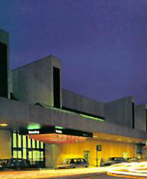
Local Area Information
Delta Airlines Atlanta:
404.765.5000
Toll Free: 800.221.1212
www.delta.com
AirTran Airways
Toll Free: 1.800.247.8726
www.airtran.com
American Airlines
Toll Free: 1.800.223.5436
www.aa.com
United Airlines
Toll Free: 1.800.241.6522
www.united.com
Hartsfield-Jackson Atlanta International Airport 574 Airport South Parkway Atlanta, GA 30349-8642 770.997.8015

Slide 13
Local Area Hotel Accommodations
Billeting (Dobbins)
POC: Judy Argo
678.655.4745
Judy.argo@us.af.mil
Atlanta Marriott Northwest
200 Interstate North Pkwy Atlanta, GA 30339
770.952.7900
www.marriott.com
Country Inn & Suites
4500 Circle 75 Pkwy Atlanta, GA 30339
770.956.9919
www.countryinns.com
Courtyard/Cumberland
3000 Cumberland Blvd Atlanta, GA 30339
770.952.2555
www.marriott.com
Courtyard Windy Hill
2045 South Park Place Atlanta, GA 30339
770.955.3838
www.marriott.com
Doubletree Hotel Atlanta NW
2055 South Park Place Atlanta, GA 30339-2014 770.272.9441
www.doubletree1.hilton.com
Embassy Suites/Galleria
2815 Akers Mill Road Atlanta, GA 30339
678.460.2568
http://embassysuites1.hilton.com/
Hilton Garden Inn
3045 Windy Hill Road Atlanta, GA 30339
770.953.8850
www.hiltongardeninn.com
Hyatt Place Galleria
2876 Spring Hill Pkwy Smyrna, GA 30080 770.384.0060
http://atlantagalleria.place.hyatt.com/
Hyatt Regency Suites
2999 Windy Hill Road Marietta, GA 30067 770.956.1234
http://atlantasuites.hyatt.com/
Hilton Marietta Hotel & Conference Center
500 Powder Springs Street Marietta, GA 30064 770.427.2500
www1.hilton.com
Renaissance Waverly (a Marriott property)
2450 Galleria Pkwy Atlanta, GA 30339
770.953.4500
www.marriott.com
•Sheraton Suites Galleria
2844 Cobb Pkwy SE Atlanta, GA 30339
770.955.3900
www.sheratonsuitesgalleriaatlanta.com
Popular/Preferred by students

Slide 14
Restaurants
Blue Ridge Grill (Steaks & Seafood)
1261 W. Paces Ferry Road Atlanta, GA 30327 404.233.5030
www.blueridgegrill.com
C & S Seafood and Oyster Bar (Steaks & Seafood) 3240 Cobb Parkway SE Atlanta, GA 30339 770.272.0999 www.candsoysterbar.com/
Capital Grille (Steaks & Seafood)
255 E. Paces Ferry Road Atlanta, GA 30305 404.262.1162
94 Perimeter Center West Dunwoody, GA 30346 770.730.8447
www.thecapitalgrille.com
Ray's on the River (Steaks & Seafood)
6700 Powers Ferry Road Sandy Springs, GA 30339 770.955.1187
www.raysrestaurants.com
South City Kitchen - Vinings (Southern American) 1675 Cumberland Parkway,
1 Ivy Walk Smyrna, GA 30080
770.435.0700
www.southcitykitchen.com
Cheesecake Factory (Continental)
1609 Cumberland Mall Atlanta, GA 30339
770.319.5515
www.thecheesecakefactory.com
Garrison’s Broiler & Tap (Steaks & Seafood)
4300 Paces Ferry Road Atlanta, GA 30339
770.436.0102
http://www.garrisonsatlanta.com
Maggiano’s Little Italy (Italian)
1601 Cumberland Mall SE, Suite 200 Atlanta, GA 30339-3162 770.799.1580
www.maggianos.com
Pappadeaux Seafood Kitchen and Mexican Cantina (Louisiana Style - Seafood)
2830 Windy Hill Road Marietta, GA 30067
770.984.8899
www.pappadeaux.com
Sal Grosso Brazilian Steakhouse (Brazilian)
1927 Powers Ferry Road SE Atlanta, Georgia 30339 770.850.1540
www.salgrosso.com
Shillings on the Square (Continental)
19 North Park Square Marietta, GA 30060
770.428.9520
www.shillingsonthesquare.net
West Cobb Diner
3451 Ernest Barrett Parkway
Marietta, GA 30064
770.422.7717
www.westcobbdiner.com

Slide 15
Local Area Attractions
The Fox Theatre
660 Peachtree Street NE Atlanta, GA 30308 404.881.2100
www.foxtheatre.org
Georgia Aquarium
255 Baker Street NW Atlanta, GA 30313
404.581.4000
www.georgiaaquarium.org
The Martin Luther King Center
449 Auburn Ave NE Atlanta, GA 30312
404.893.9882
www.thekingcenter.org
Piedmont Park
1320 Monroe Drive NE Atlanta, GA 30316 404.875.7275
www.piedmontpark.org
Stone Mountain
US Hwy 78 East, Atlanta, GA 30087
770.498.5690
www.stonemountainpark.com
Suntrust Park (Atlanta Braves)
755 Battery Ave, Atlanta GA 30315
404.522.7630
www.atlantabraves.com
World of Coca-Cola
121 Baker Street Atlanta, GA 30313
404.676.5151
www.worldofcoca-cola.com
Zoo Atlanta
800 Cherokee Avenue Atlanta, GA 30315
404.624.9453
www.zooatlanta.org

Slide 16
Local Area Attractions
Cobb Symphony Orchestra
2250 Stilesboro Road NW Kennesaw, Georgia 30152
770.429.7016
www.georgiasymphony.org
The Georgia Ballet
1255 Field Parkway Marietta, GA 30066
770.528.0881
www.georgiaballet.org
The Strand Theatre
117 North Park Square Marietta, GA 30060-1971
770.429.9973
www.earlsmithstrand.org
Marietta Gone With the Wind Museum
18 Whitlock Avenue Marietta, GA 30064
770.794.5576
www.gwtwmarietta.com
Marietta Museum of History
1 Depot Street, Suite 200 Marietta, GA 30060 770.794.5710
www.mariettahistory.org
Marietta/Cobb Museum of Art
30 Atlanta Street Marietta, GA 30060-1975 770.528.1444
www.mariettacobbartmuseum.org
Cobb Landmarks & Historical Society
30 Atlanta Street, SE Marietta, GA 30060 678.594.4994
www.cobblandmarks.com
Mable House Amphitheatre
5239 Floyd Road , SW Mableton, GA 30126 770.819.2943
www.mablehouse
Atlanta Botanical Garden
1345 Piedmont Avenue NE Atlanta, GA 30309 404.876.5859
www.atlantabotanicalgarden.org
CNN Center
One CNN Center Atlanta, GA 30348
404.827.2300 www.cnn.com

Slide 17
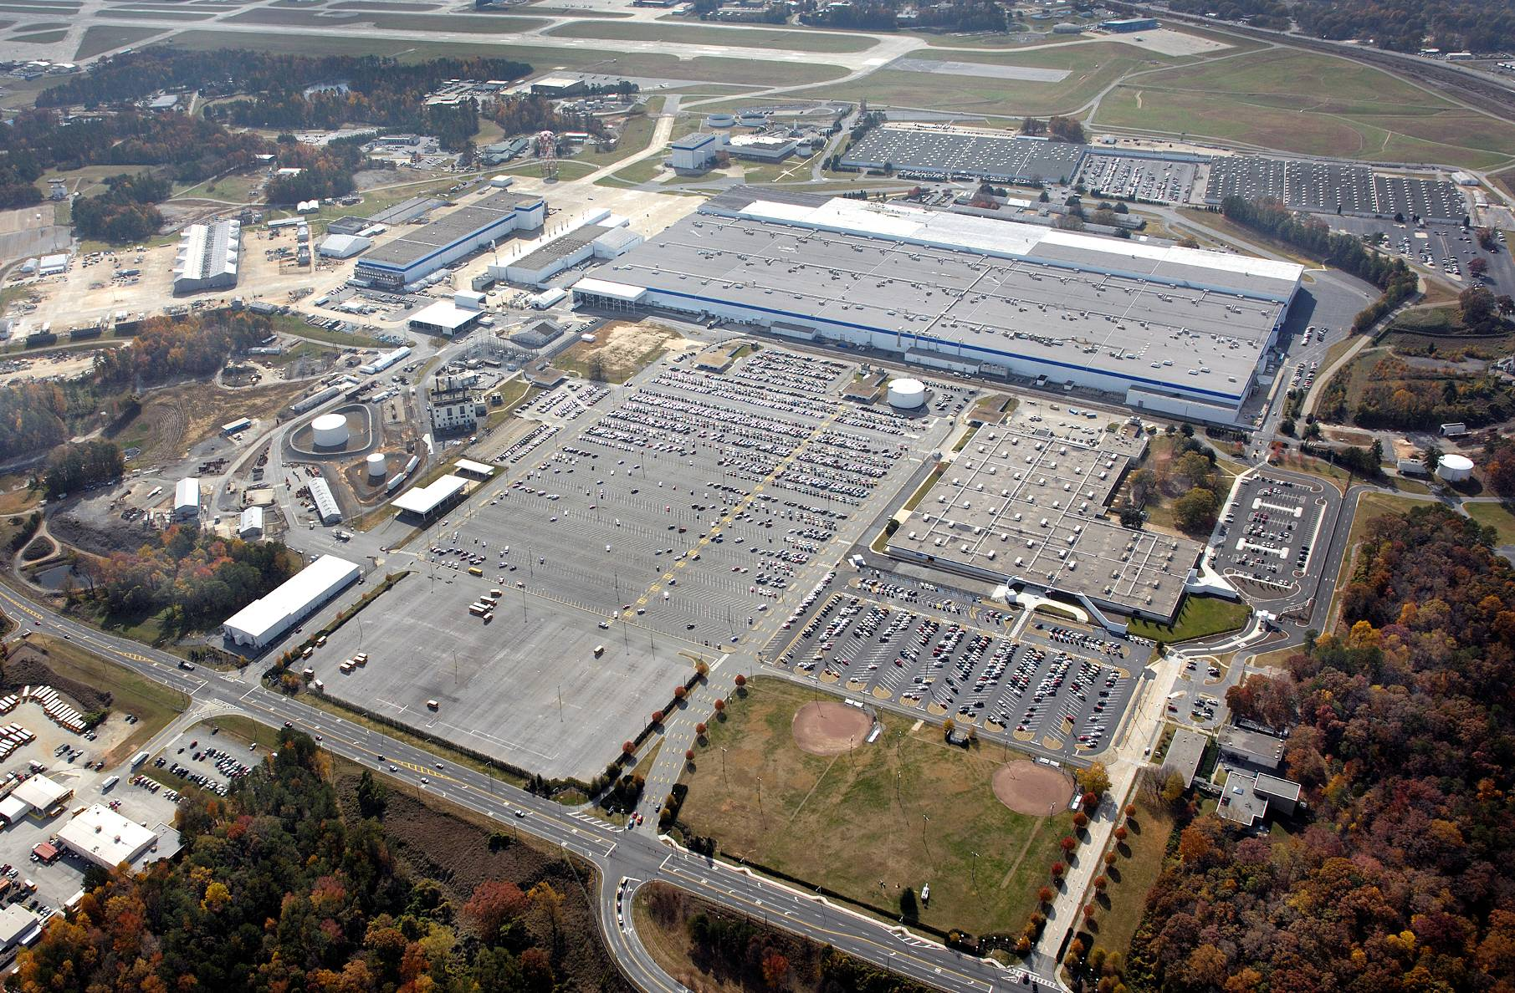
Lockheed Martin Aeronautics North Campus
B-1
B-95
B-68
B-67

Slide 18
B-95 Lobby
B-67
B-68
North Gate
B-1 SIM

Slide 19
Building 67 Emergency Evacuation Route

Slide 20
Building 68 First Floor Emergency Evacuation Route

Slide 21
Building 68 Basement Emergency Evacuation Route

Slide 22
Notes
_________________________________________________________________________________________________________________________________________________________________________________________________________________________________________________________________________________________________________________________________________________________________________________________________________________________________________________________________________________________________________________________________________________________________________________________________________________________________________________________________________________________________________________________________________________________________

